Slide 1
Mathematical Methods of Uncertainty Quantification in Hydrology
Group 1: Adrien Thébault, Vincent Taneli Olander, Nafisa Raihana

Slide 2
Presentation Overview
Parameter Optimization
Local Sensitivity Analysis
Global Sensitivity Analysis

Slide 3
Parameter Optimization

Slide 4
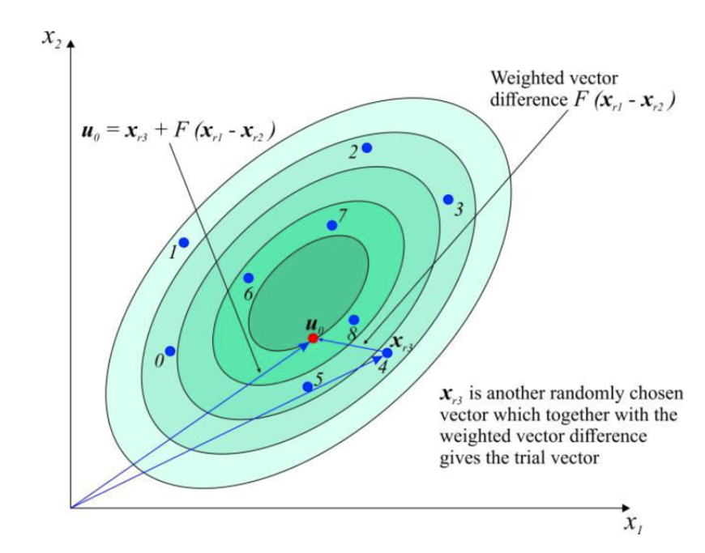
Parameter Optimization
Preconsiderations
Understanding the model and the optimization method
18 parameters which are free to chose in given bounds
4 main modules in the HBV001a model
Catchment: Bavaria, short time series
Differential Evolution
Gradient Based Optimizer

Slide 5
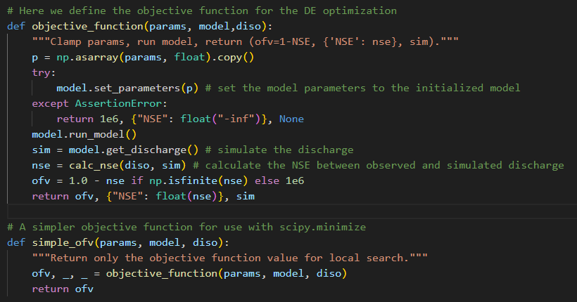
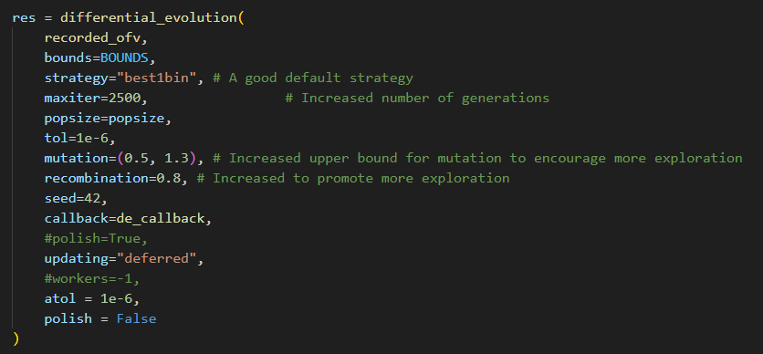
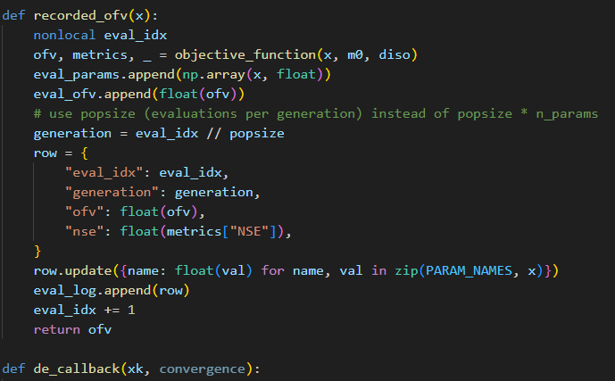
Parameter Optimization
Original Code – Differential Evolution
3

Slide 6
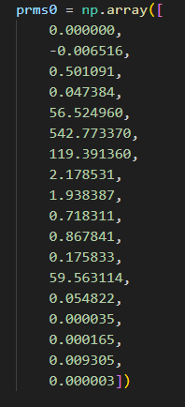
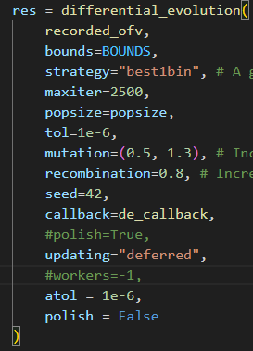
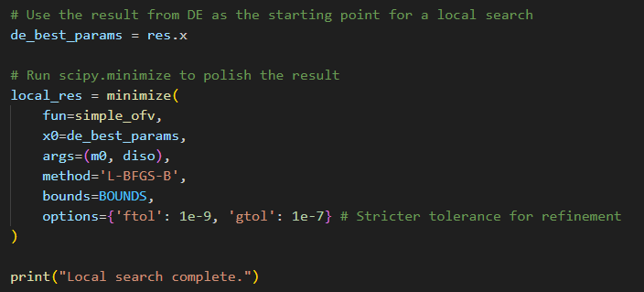
Parameter Optimization
Original Code – Tuning the Optimization
6

Slide 7
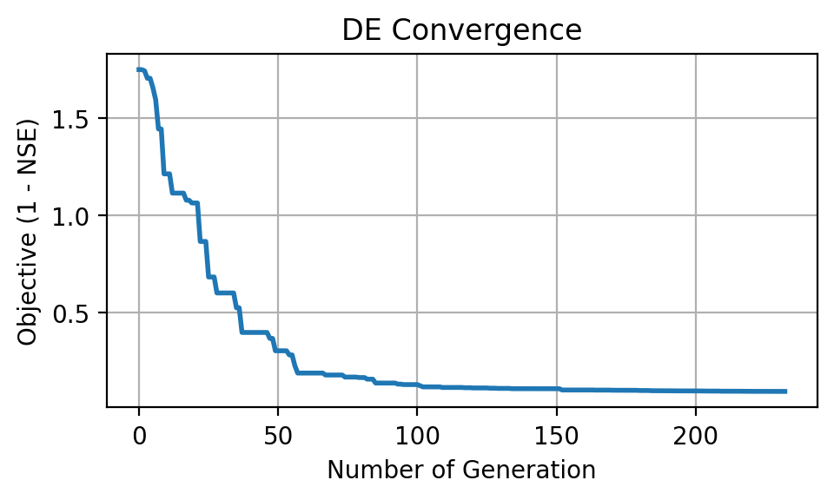
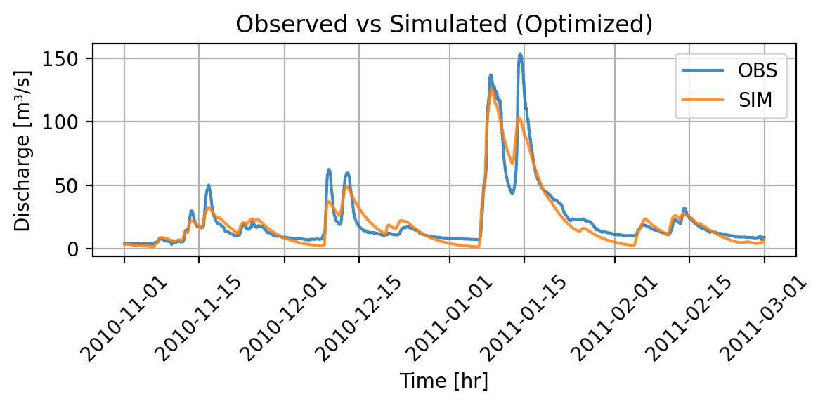
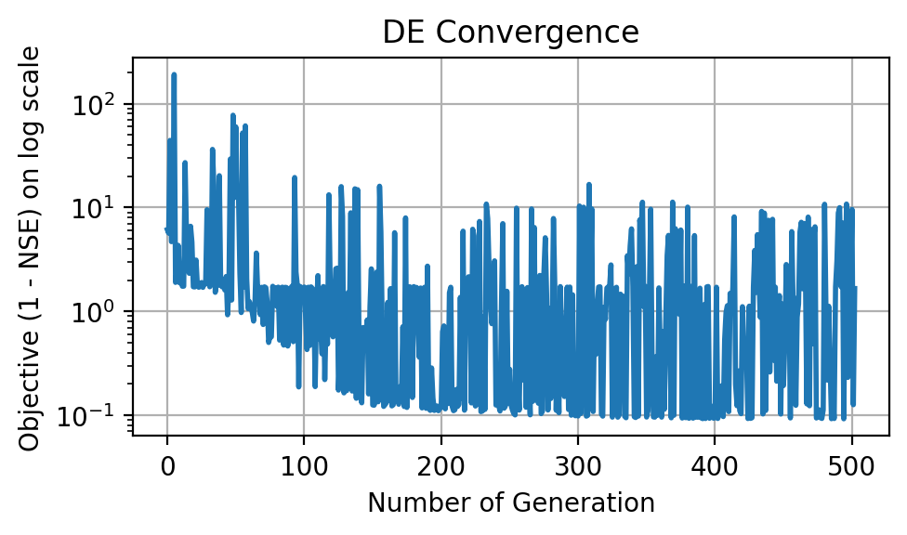
Parameter Optimization
Overall Result
NSE: 0.901
Stabilizing: ~ 100 Iterations

Slide 8
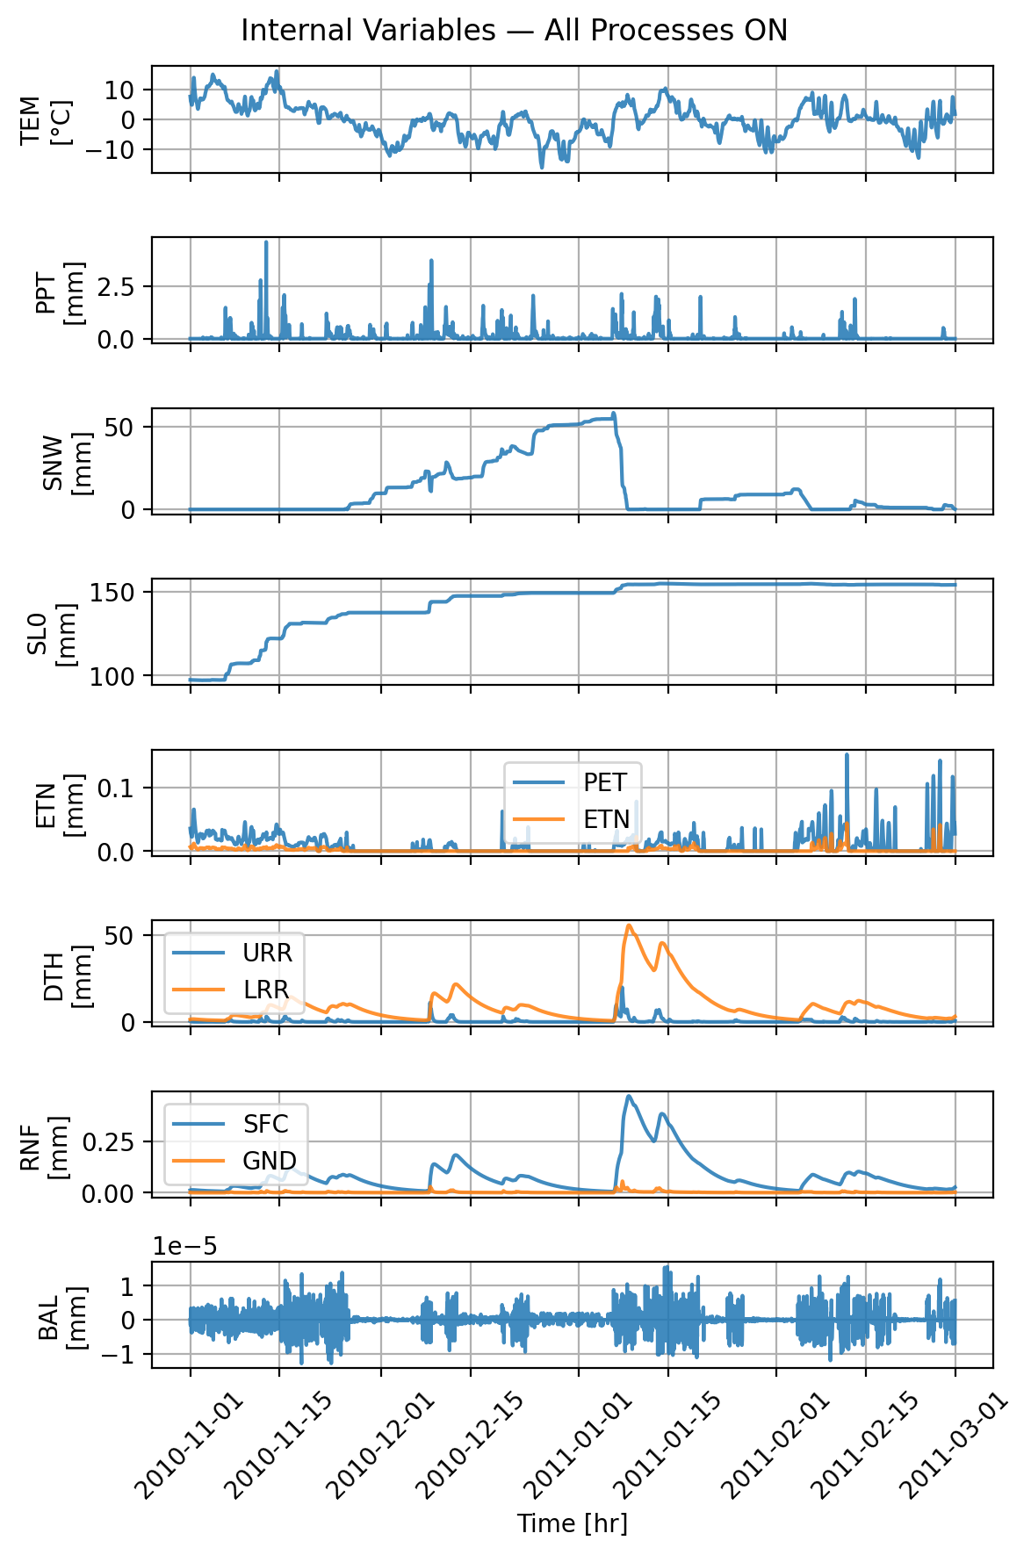
Parameter Optimization
All Parameters On
Snow initial depth: 0.000000
Snow fall/melt temperature: 0.148940
Snow melt air factor: 0.634415
Precipitation melt air factor: 0.036731
Soil initial moisture: 94.568525
Soil permanent wilting point: 432.979200
Soil field capacity: 148.866130
Soil beta: 2.659653
Storage initial upper reservoir: 1.728010
Storage initial lower reservoir: 0.739939
Upper-res. runoff split ratio: 0.748241
Percolation coefficient upper-to-lower: 0.185272
Upper-res. threshold depth: 60.579322
Upper-res. threshold coefficient: 0.143289
Upper-res. discharge to runoff coefficient: 0.000401
Upper-res. Runoff coefficient: 0.000147
Discharge rate: 0.008535
Lower-res. runoff coefficient: 0.000024

Slide 9
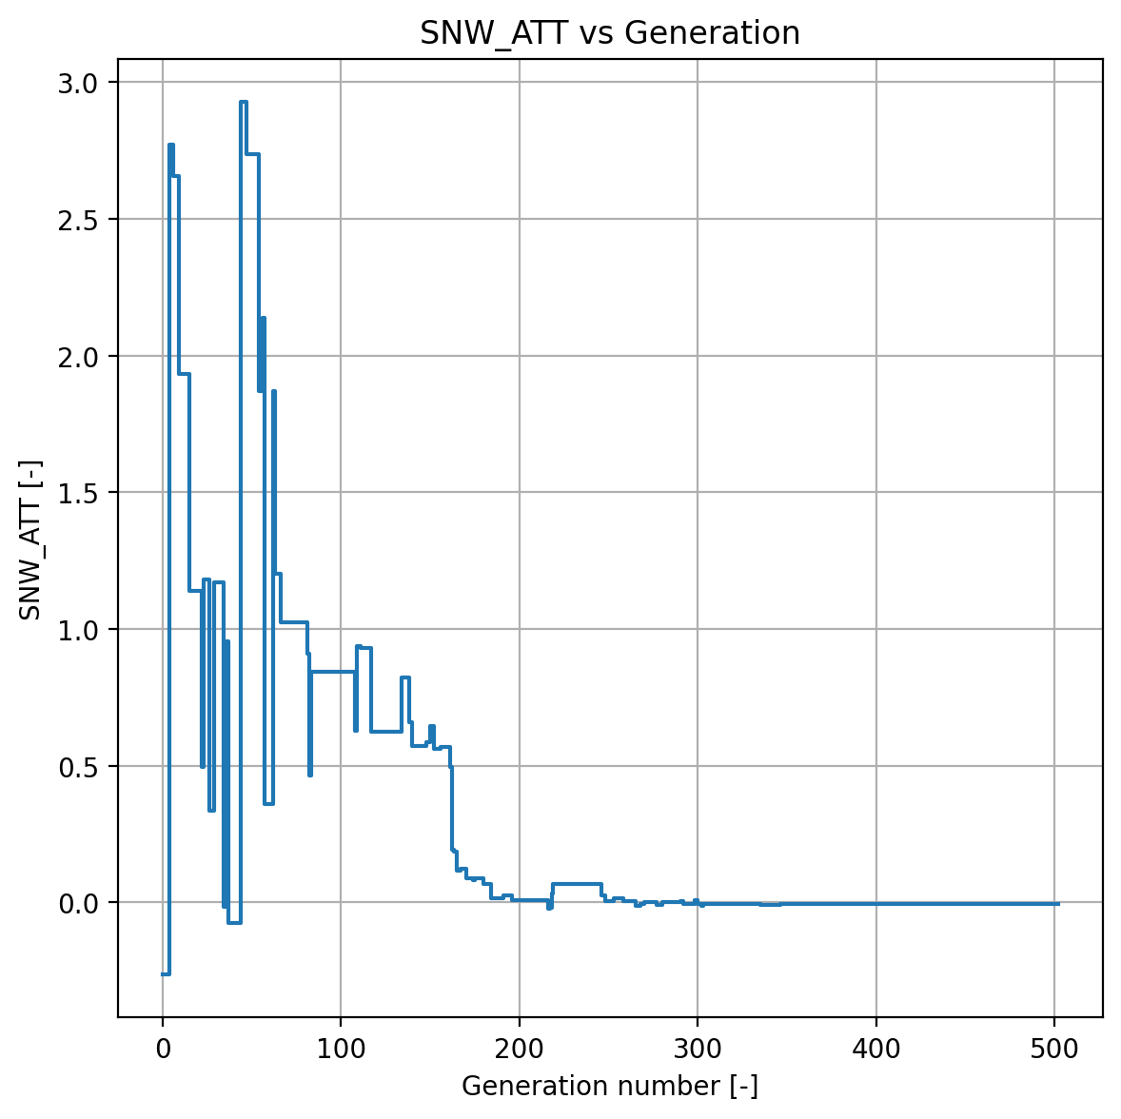
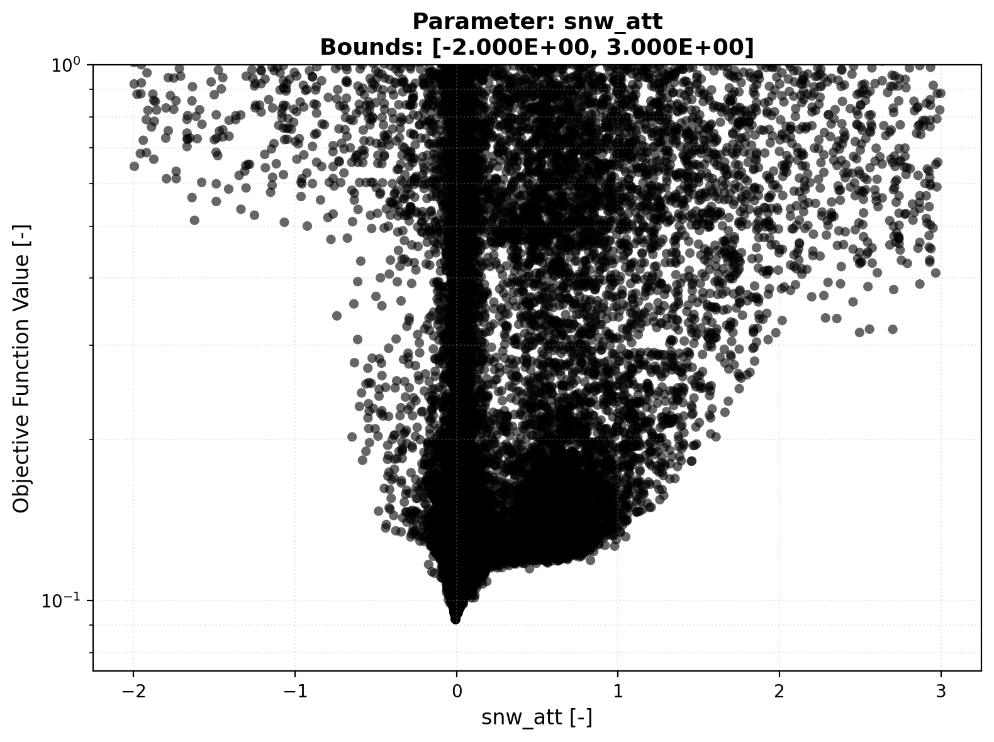

Parameter Optimization
Snow Module – SNW_ATT
The Threshold Temperature turns the snow module on and off, i.e. it controls if melt occurs or not
Convergence Plot
Scatter Plot

Slide 10
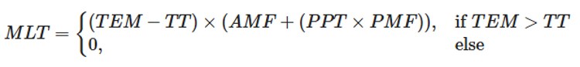
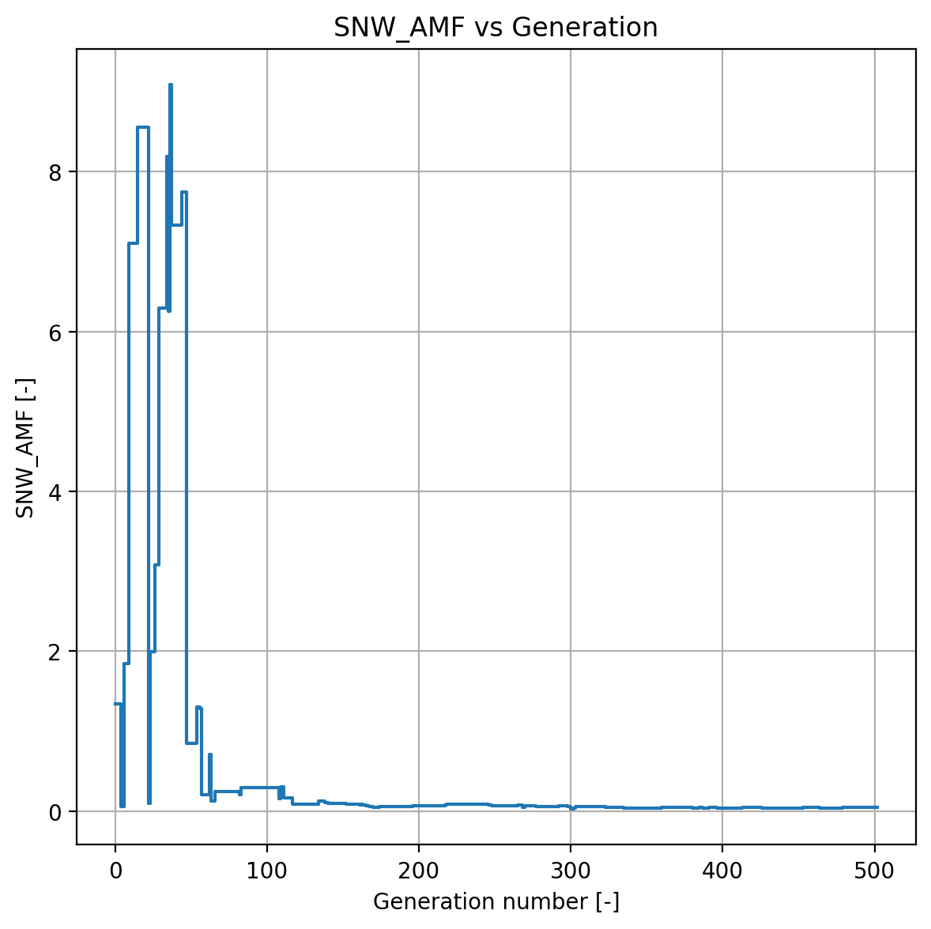
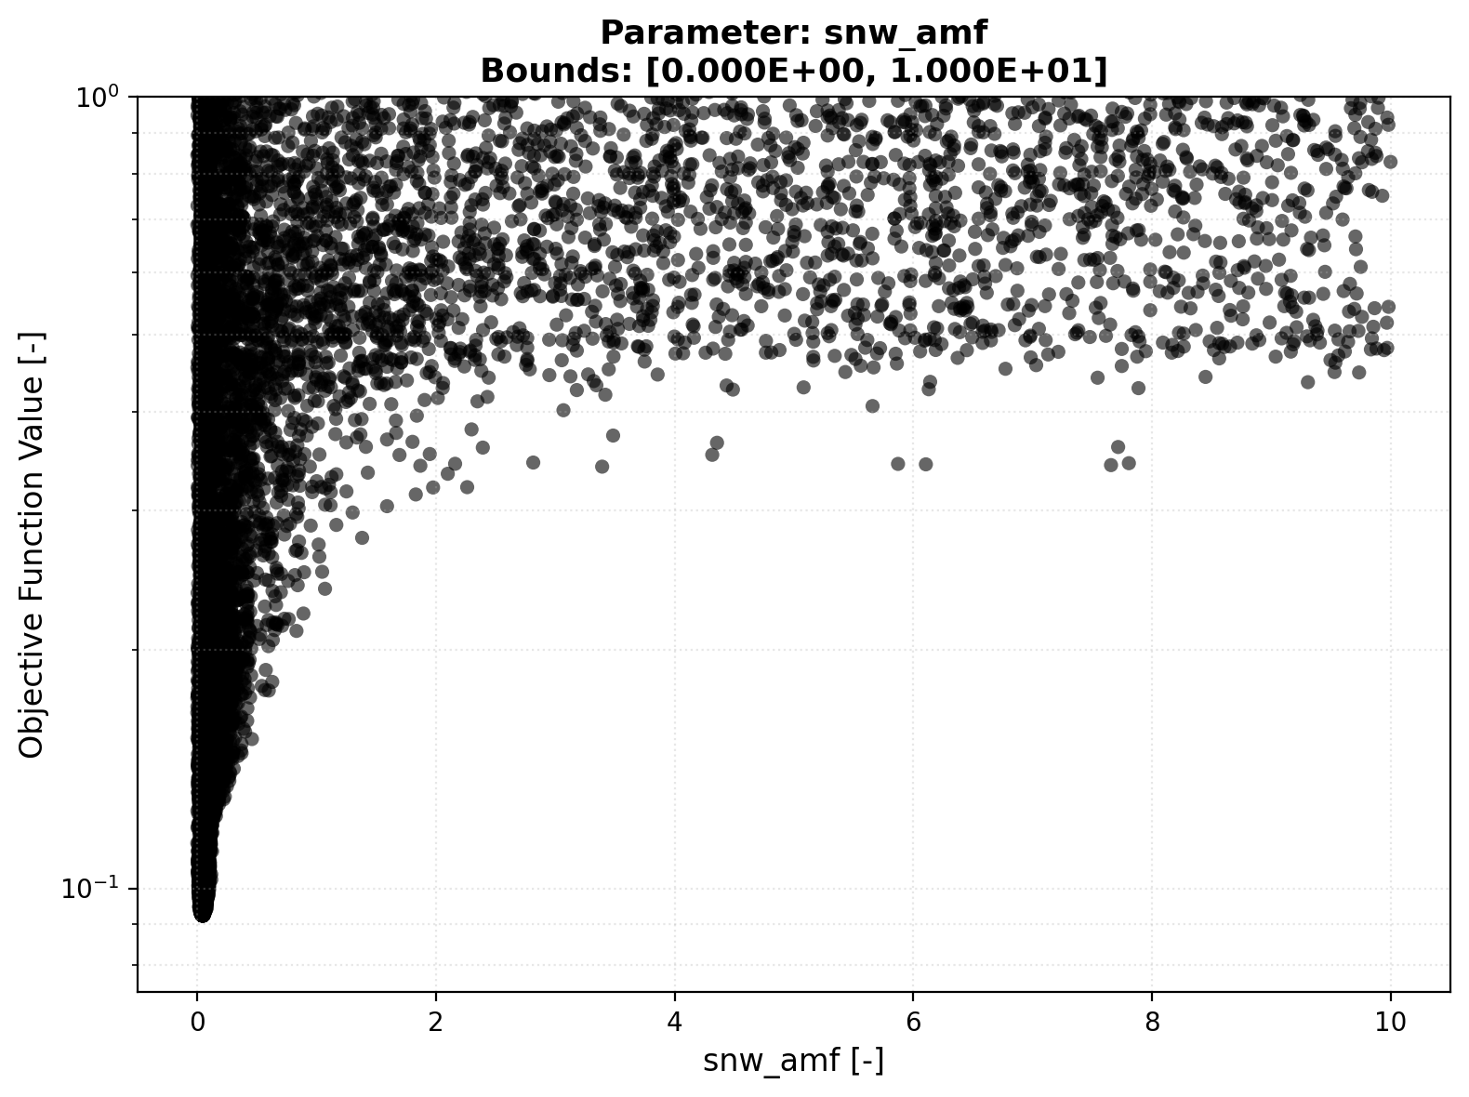
Parameter Optimization
Snow Module – SNW_AMF
The Air Temperature Melt factor (AMF) contributes to melt
Convergence Plot
Scatter Plot

Slide 11
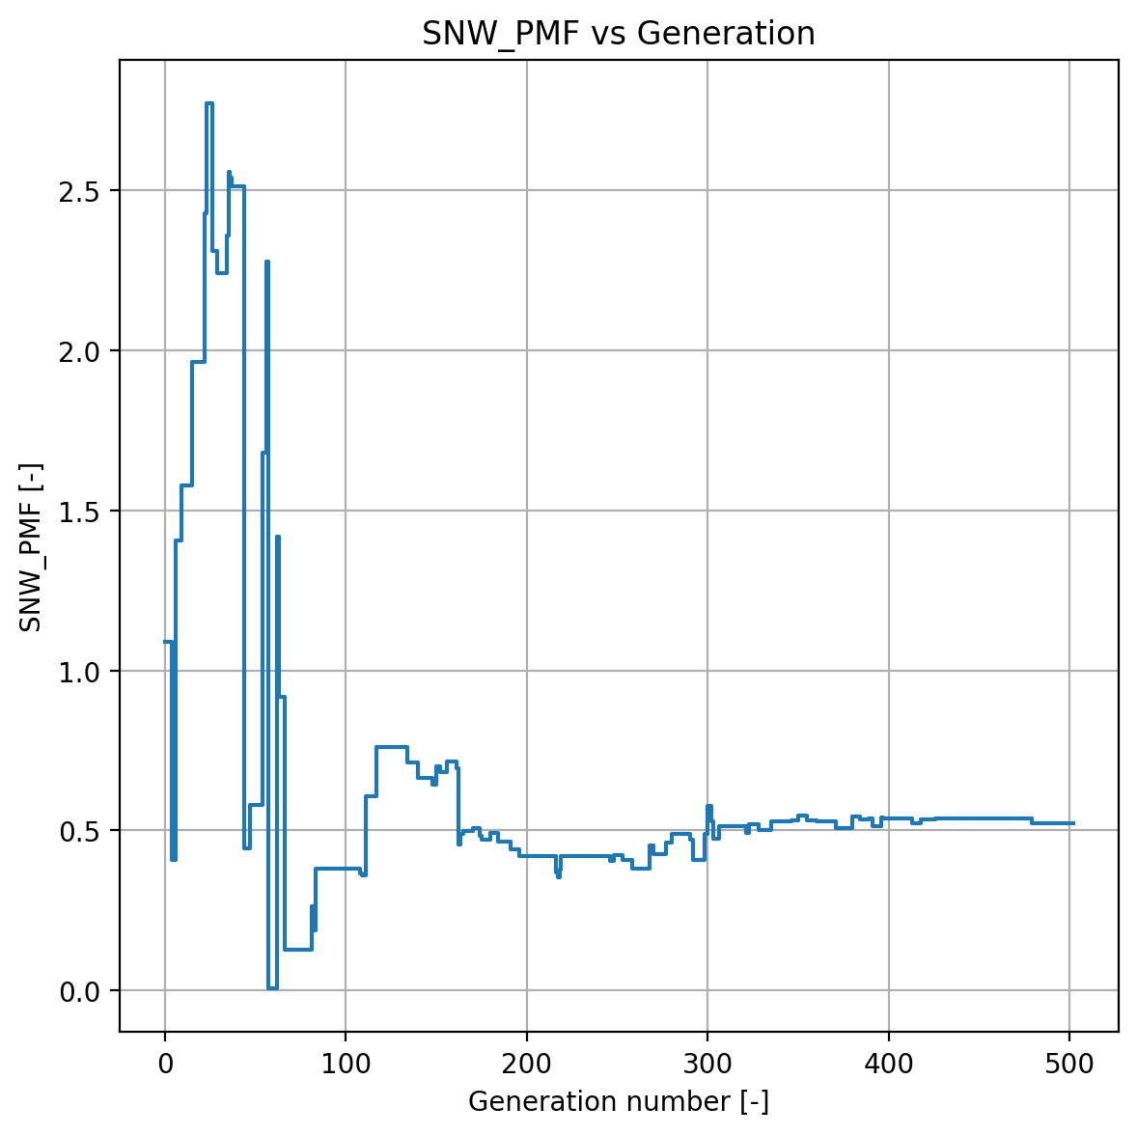
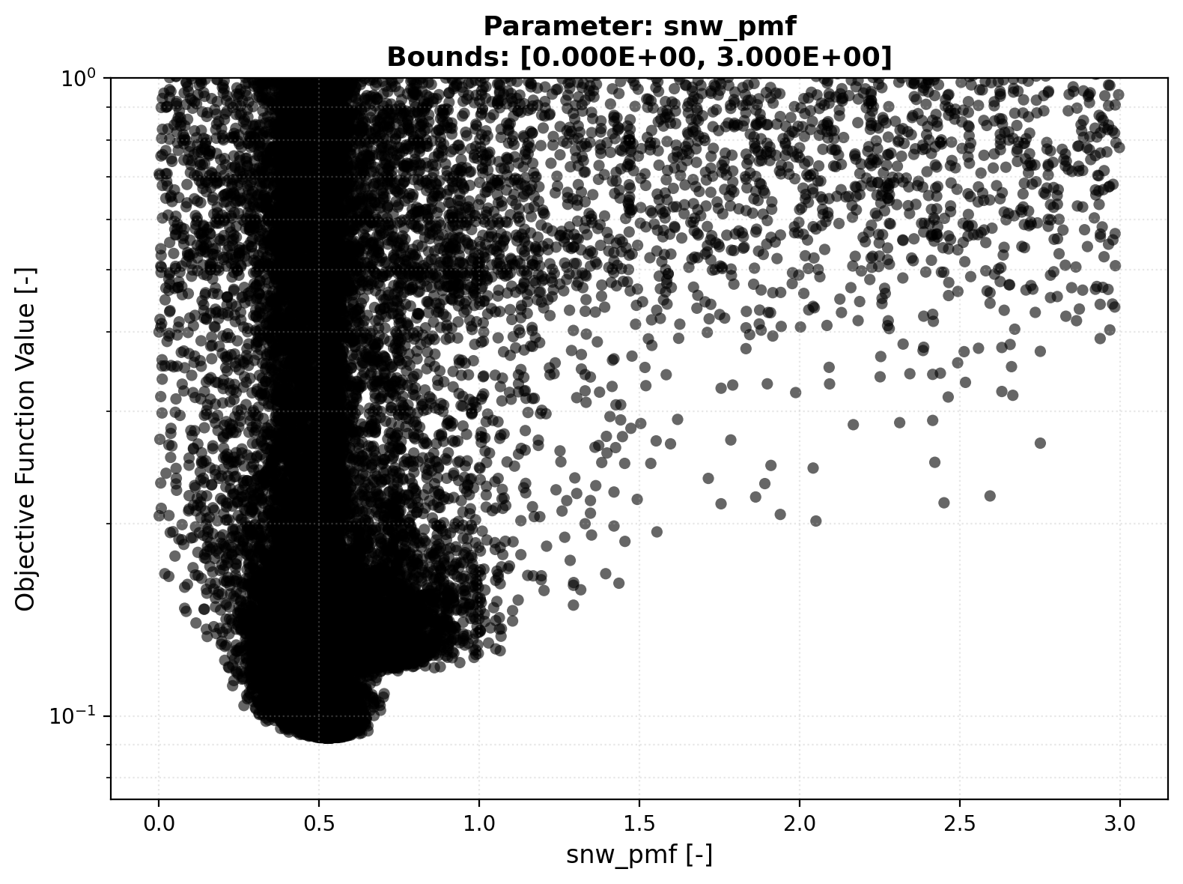
Parameter Optimization
Snow Module – SNW_PMF
The Precipitation Melt Air Factor (PMF) contributes to melt
Convergence Plot
Scatter Plot

Slide 12
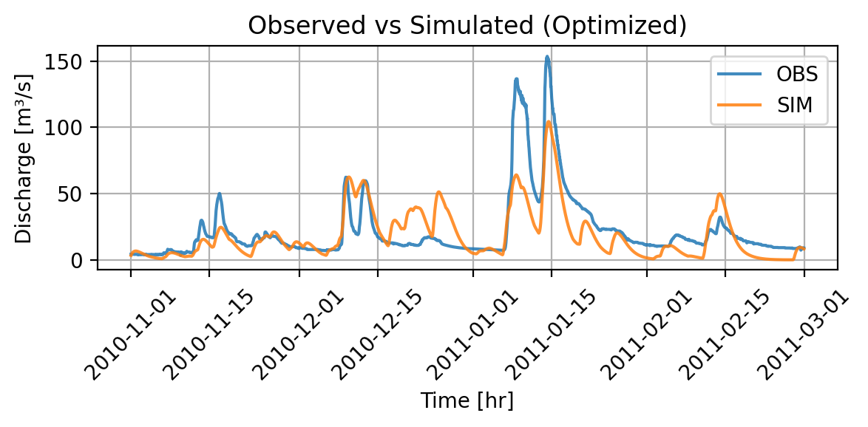

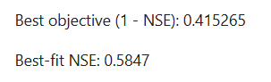
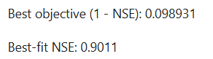
Parameter Optimization
Snow Module Off – Optimization Part 1
Simulated Discharge – snow modul off
Simulated Discharge – all modules on

Slide 13
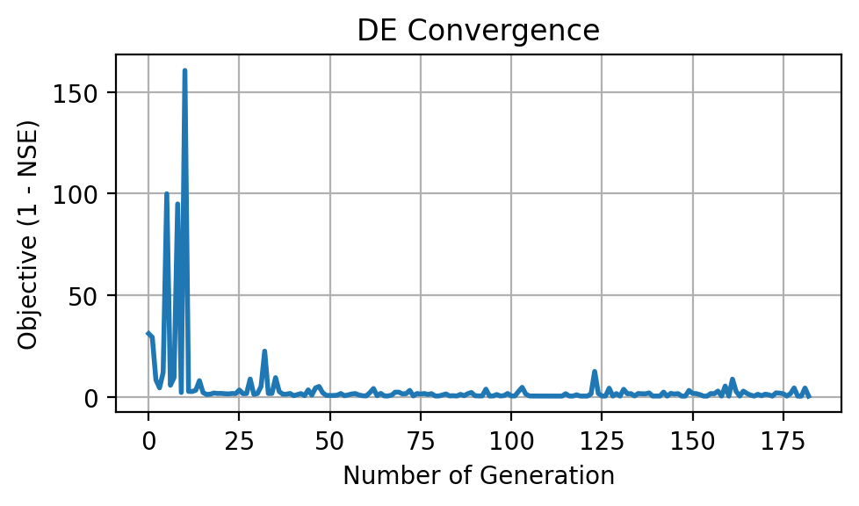
Parameter Optimization
Snow Module Off – Optimization Part 2
Schenkenau in Bavaria -> We expect melt
Less peaky as melt implies higher runoff
Interesting behavior (snow then no snow at fast melt)
High OFV
Poor convergence
Conclusion: Snow module relevant

Slide 14
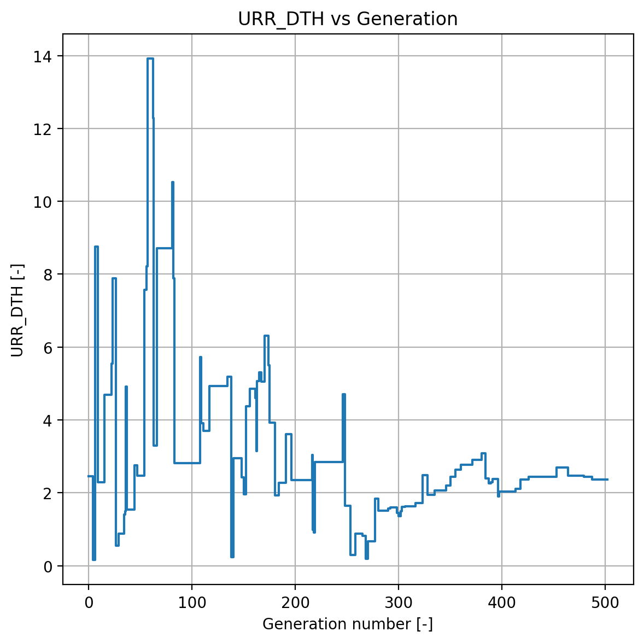
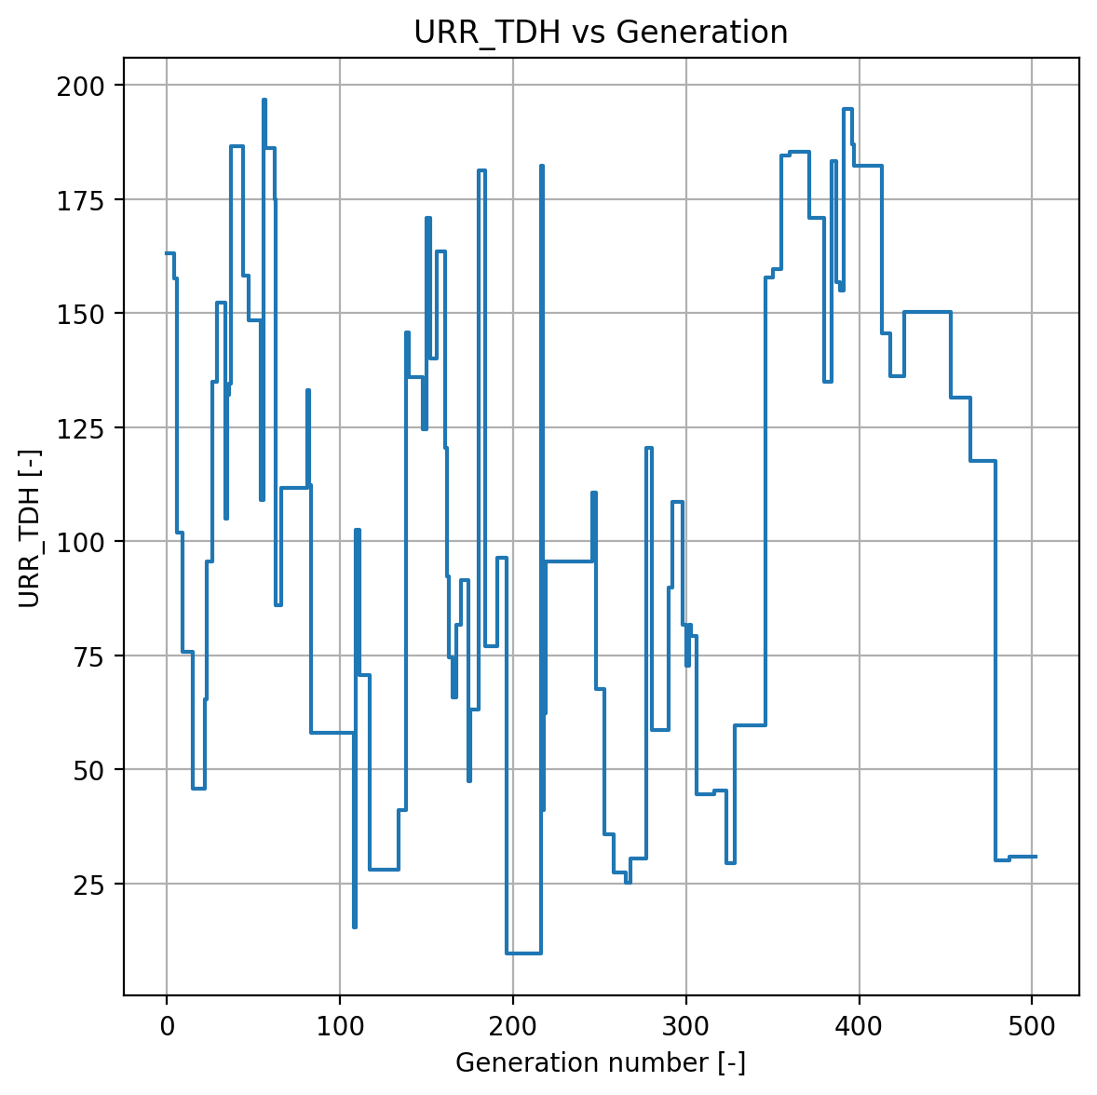
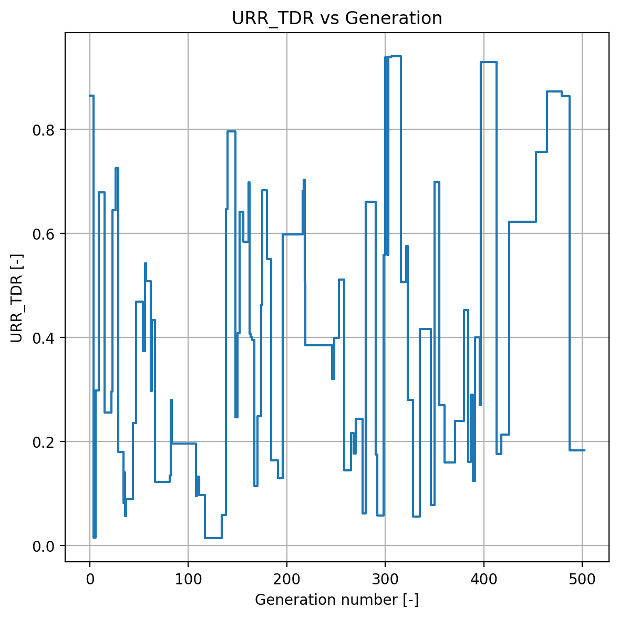
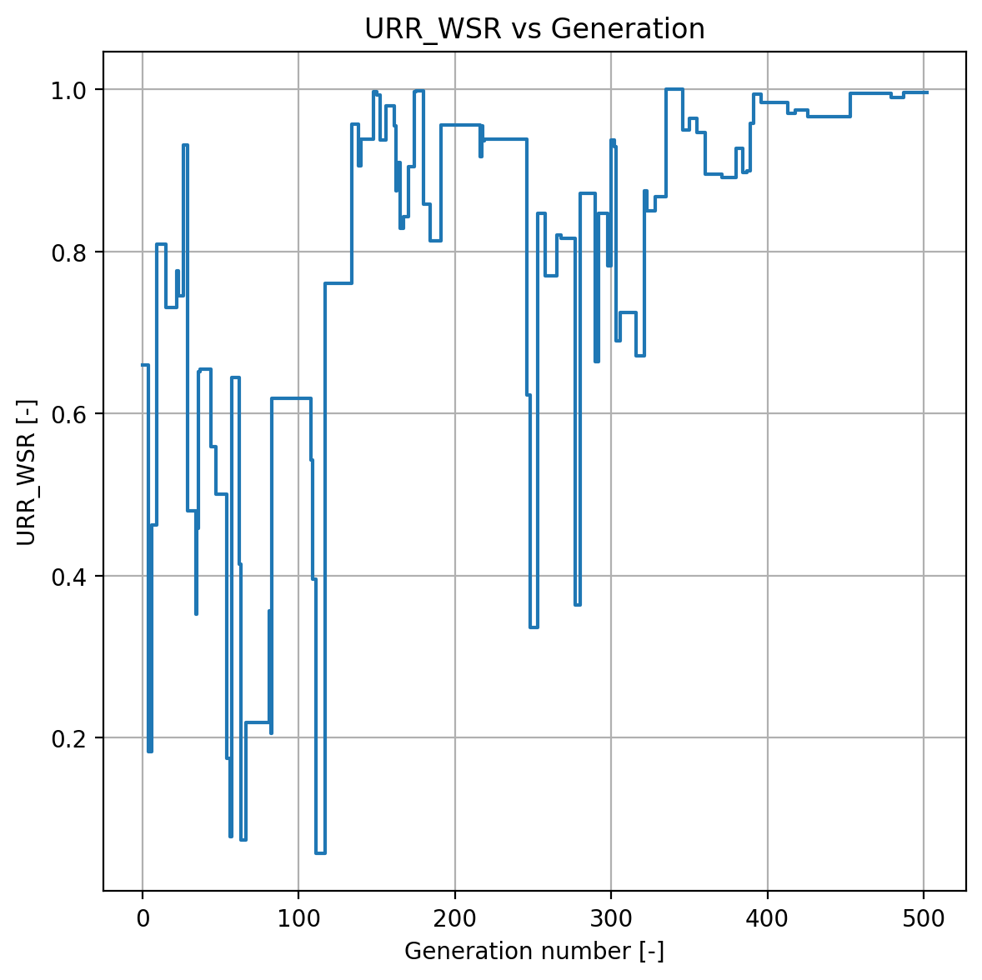
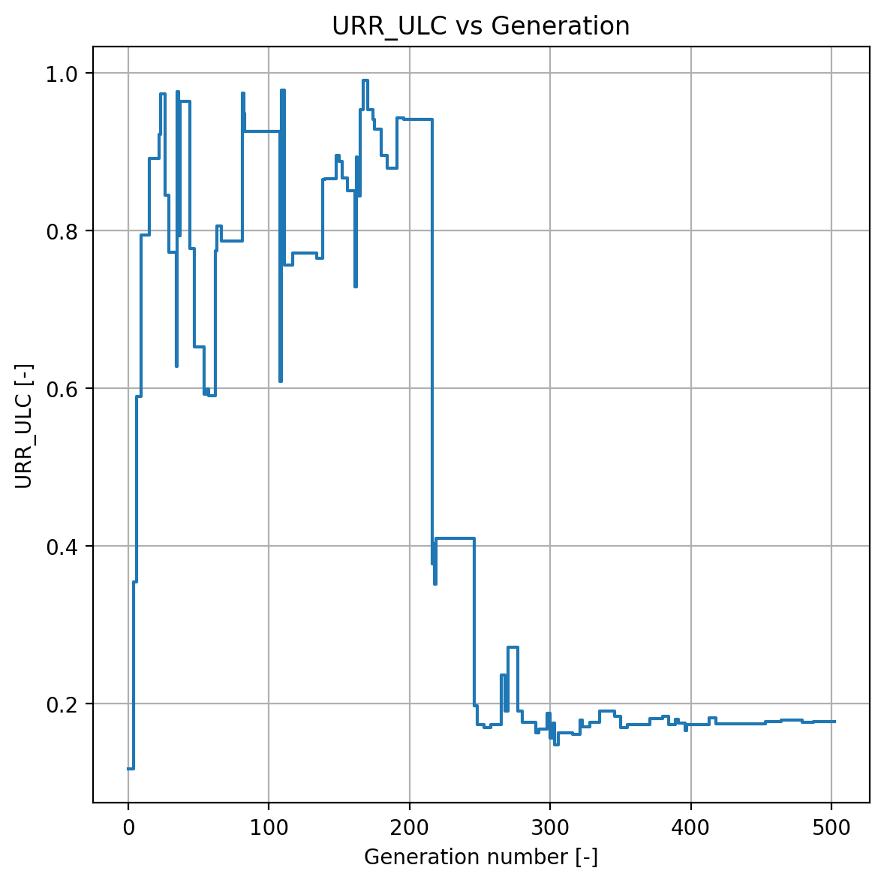
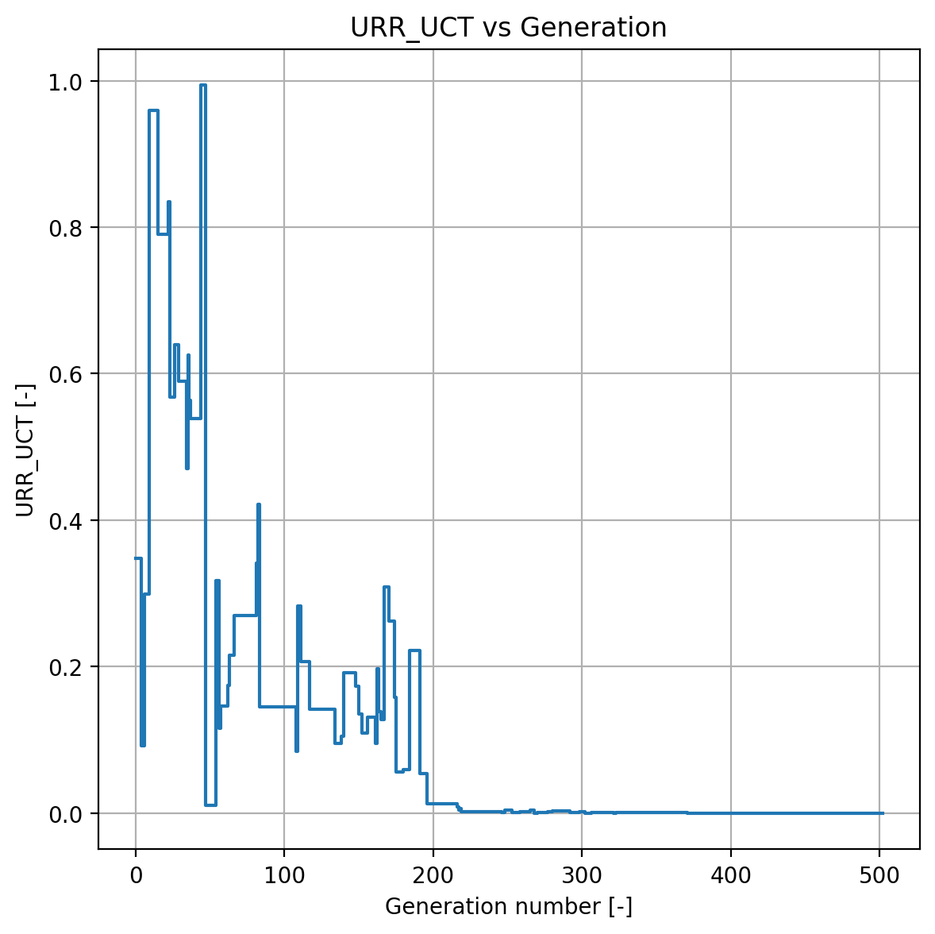
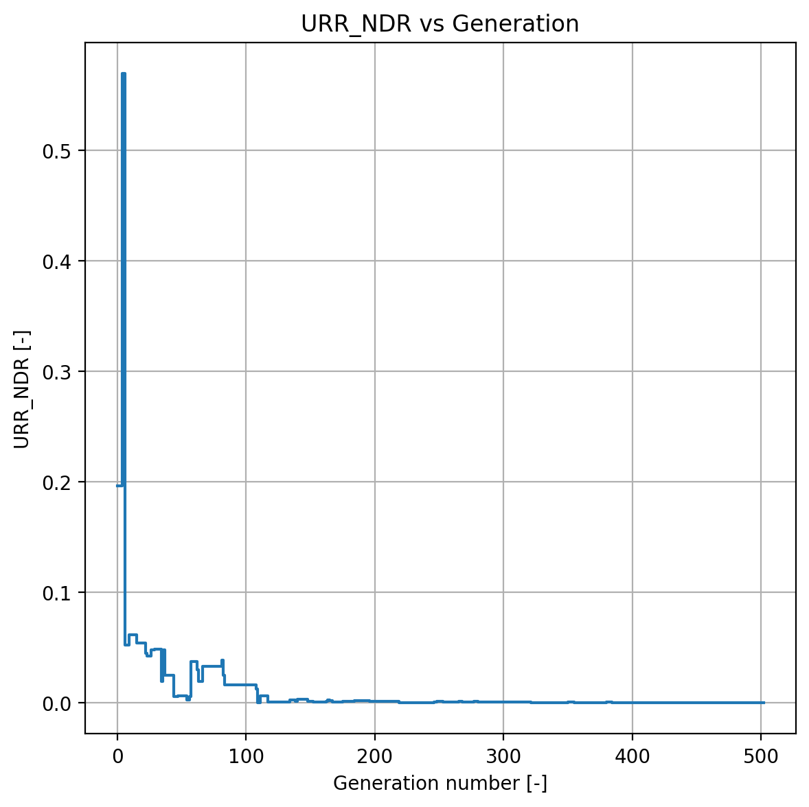
Parameter Optimization
Upper Reservoir Module – All parameters
The URR controls the fast flow only if the threshold depth is attained

Slide 15
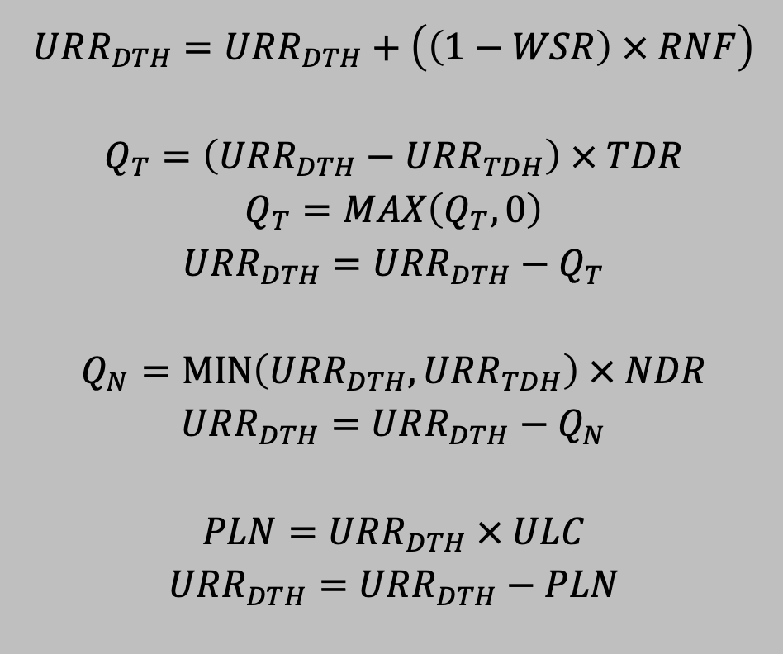
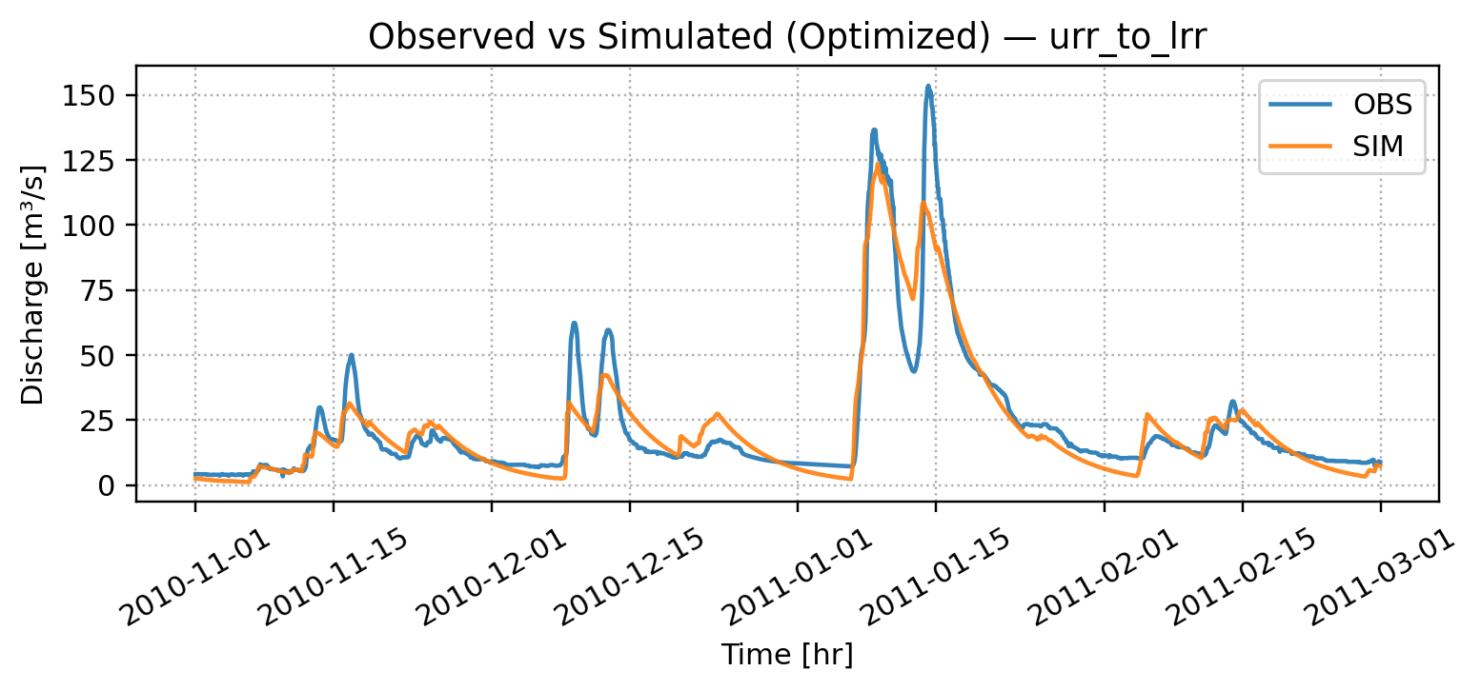
Parameter Optimization
Turning URR Module (fast surface flow) off
WSR = 0
URR_TDH​ = very large (≈1000)
TDR=0, NDR=0
ULC=1
Result:
PLN=RNF,Q_T=0,Q_N=0
URR acts as a pass-through to LRR, with no direct quickflow.
NSE = 0.8874

Slide 16
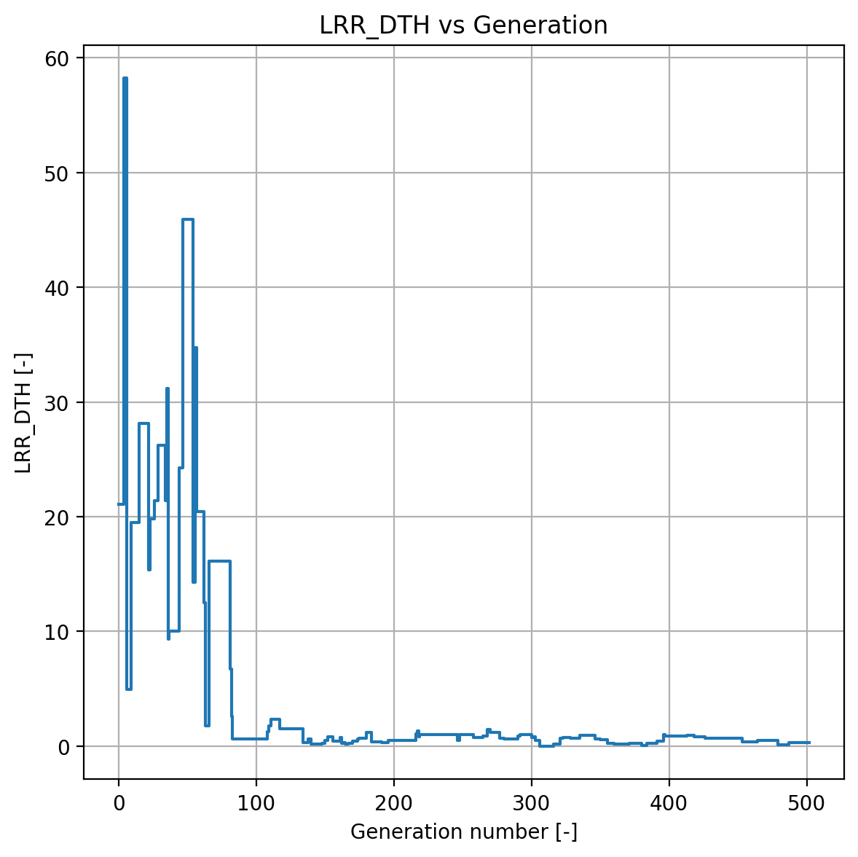
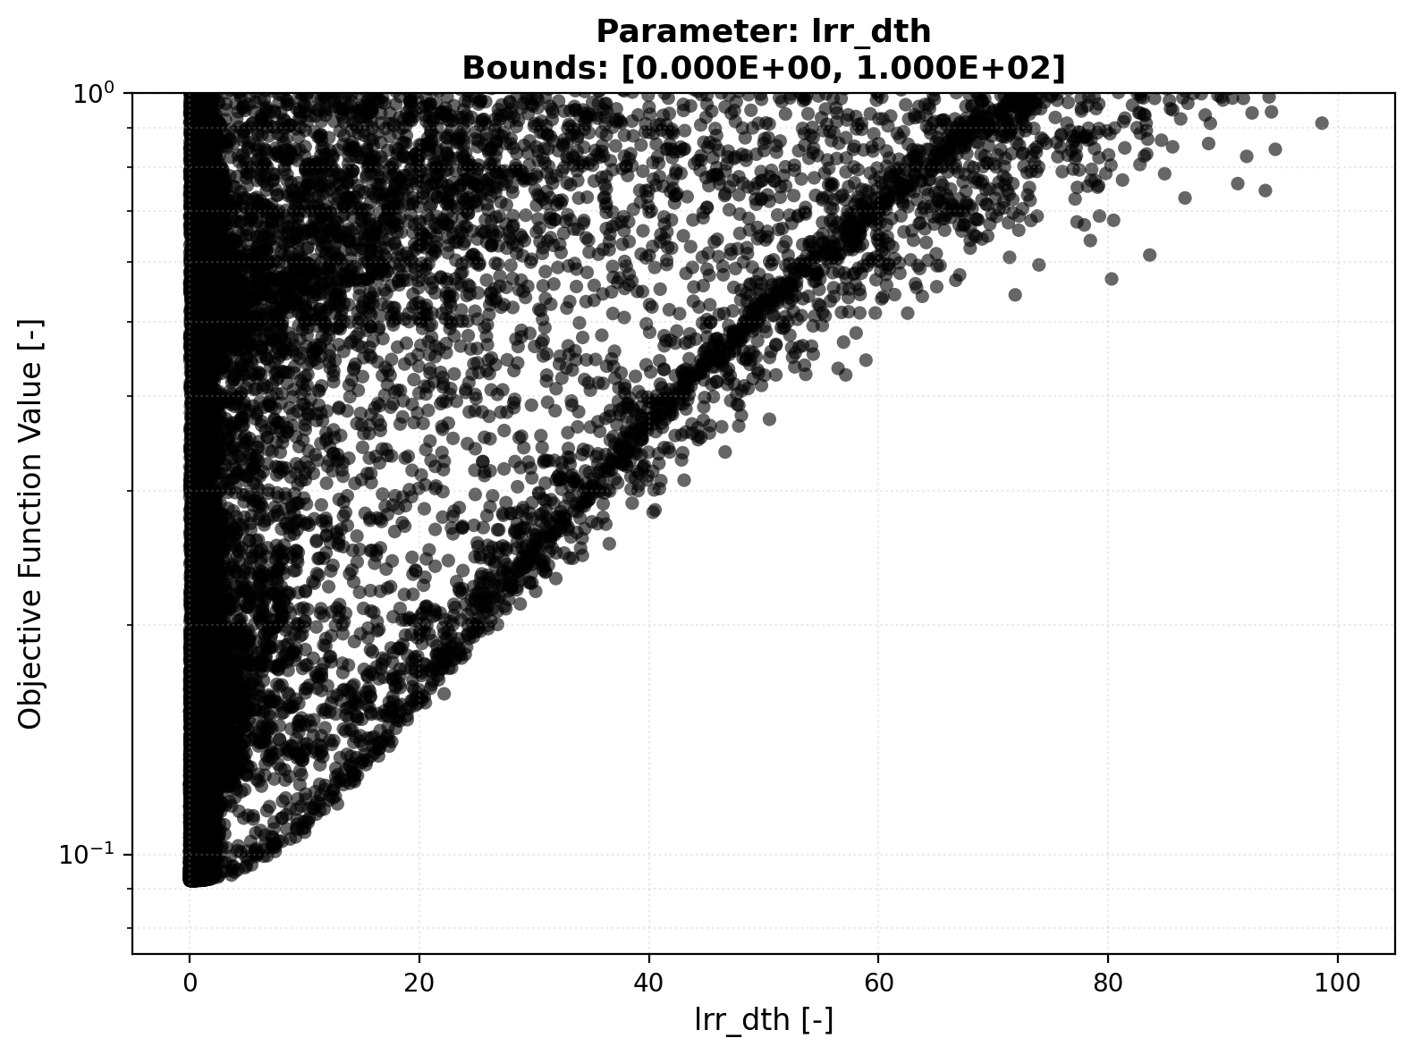
Parameter Optimization
Lower Reservoir Module – LRR_DTH
The Lower Reservoir Depth gives the max. storage capacity
Convergence Plot
Scatter Plot
Internal Variables

Slide 17
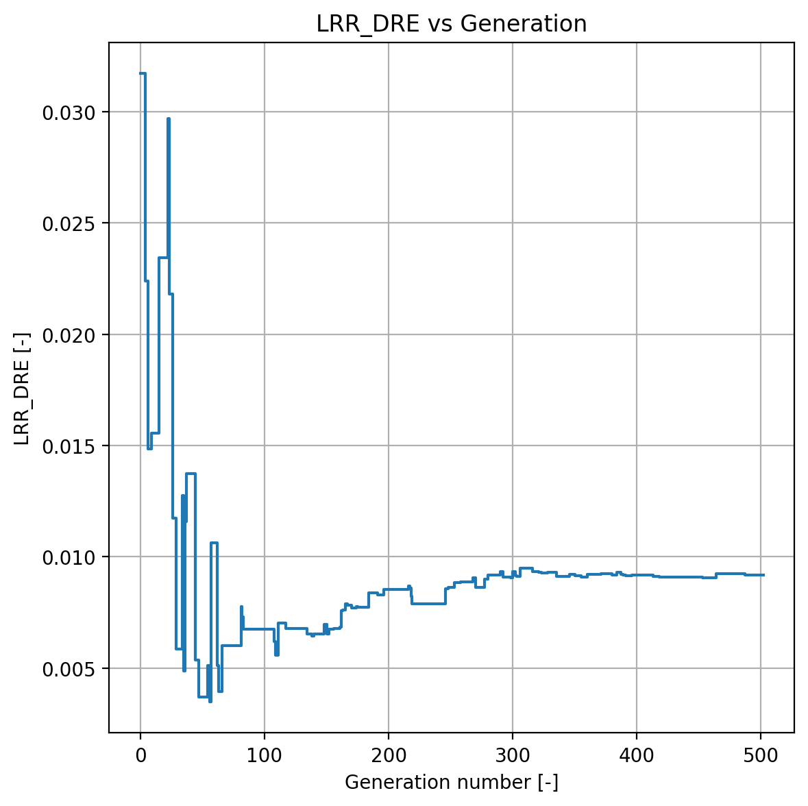
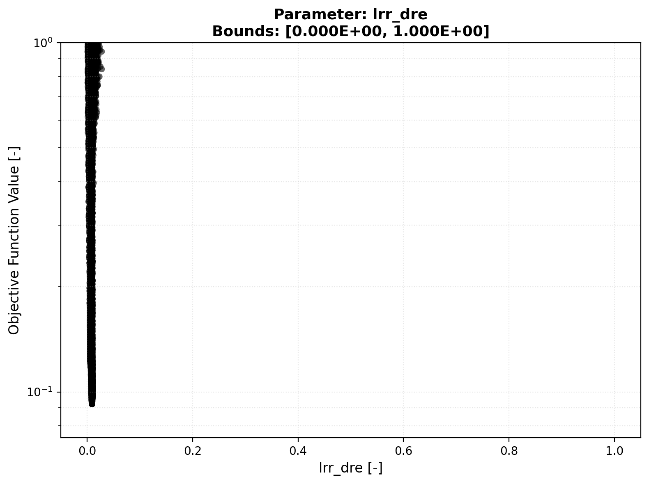
Parameter Optimization
Lower Reservoir Module – LRR_DRE
The Lower Reservoir Discharge Efficieny factor is the fraction of water that discharges as slow baseflow
Convergence Plot
Scatter Plot
Internal Variables

Slide 18
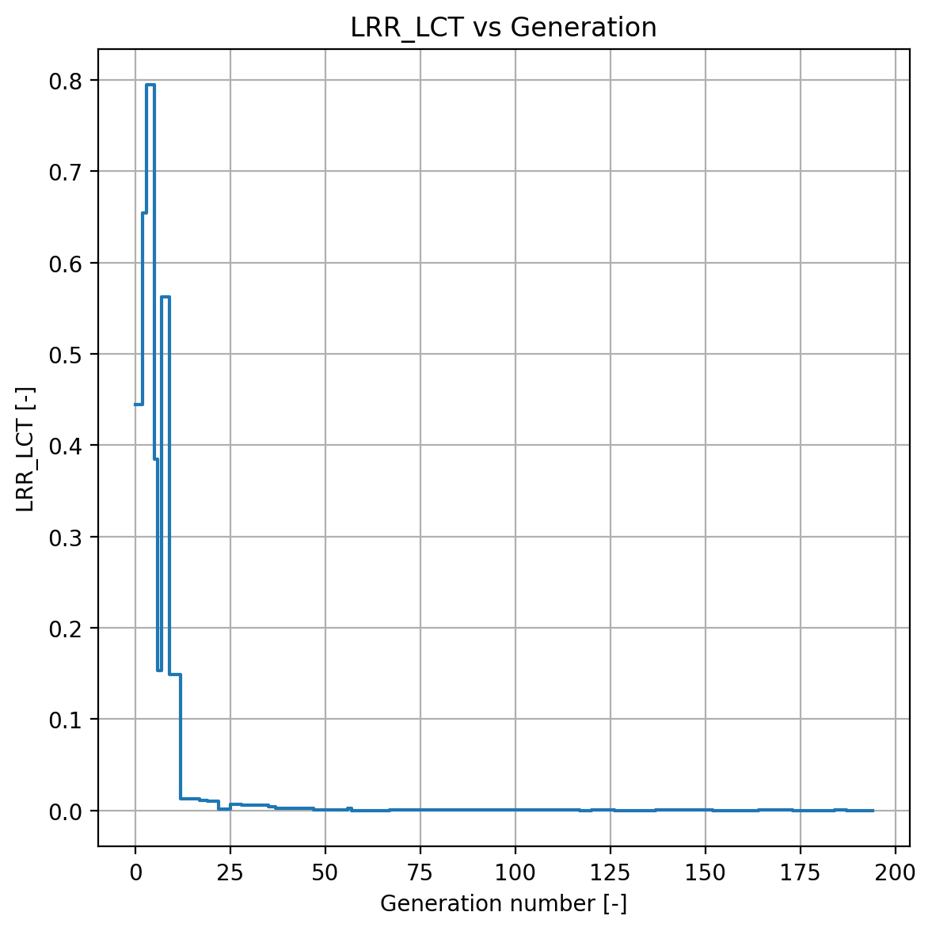
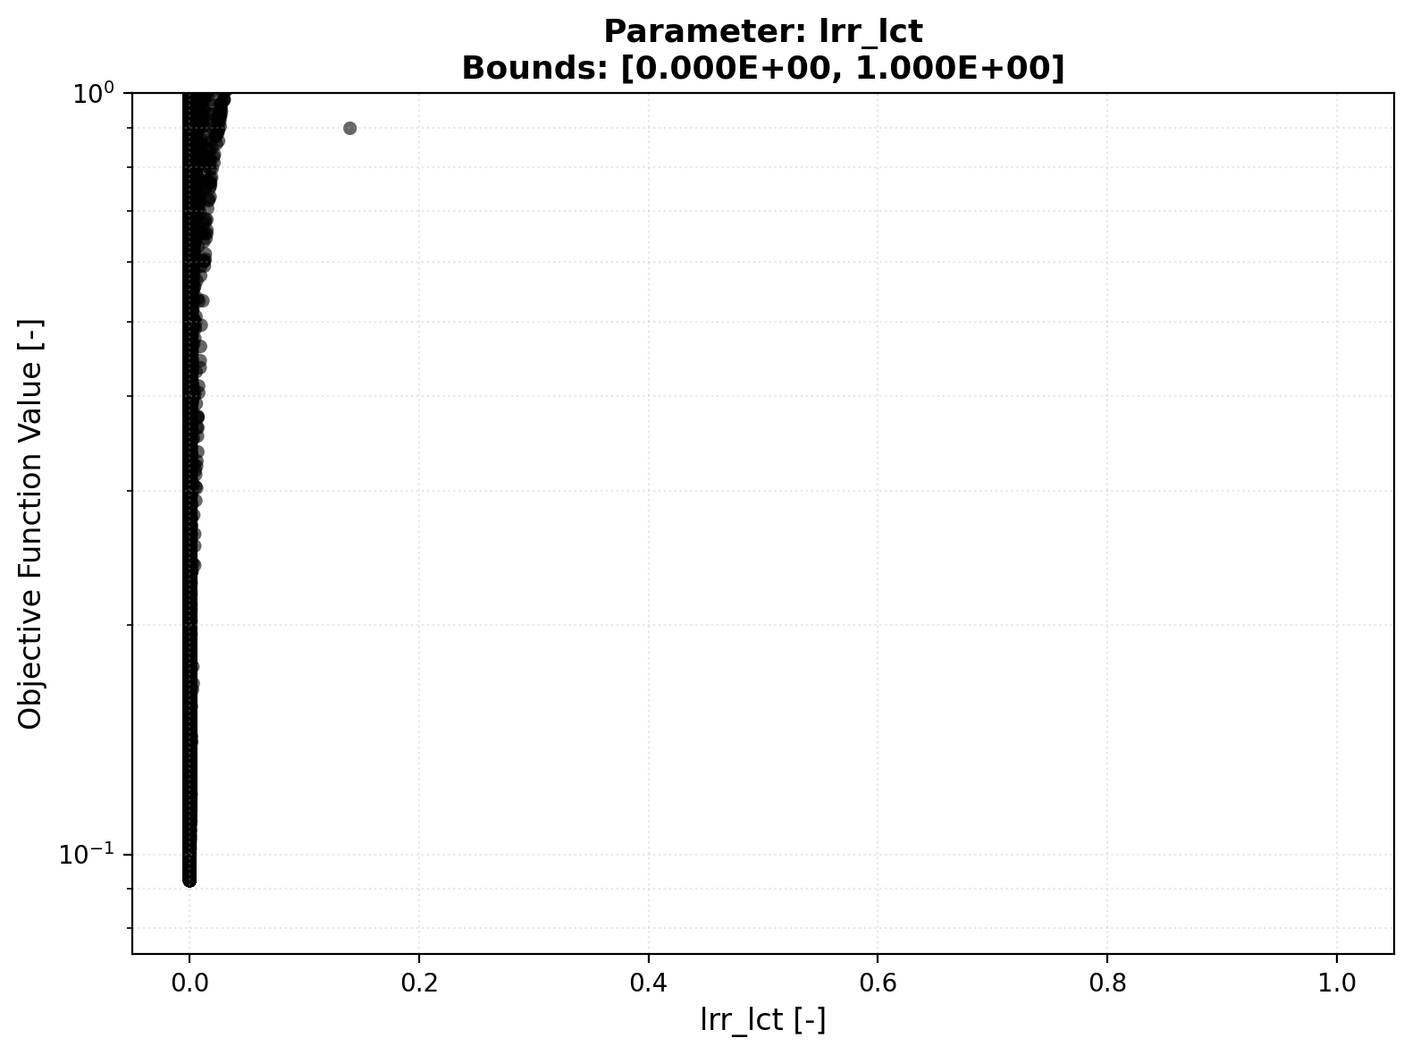
Parameter Optimization
Lower Reservoir Module – LRR_LCT
The Lower Reservoir Cell Transfer Coef. is the fraction of water released in each step (cannot see it)
Convergence Plot
Scatter Plot
Internal Variables

Slide 19
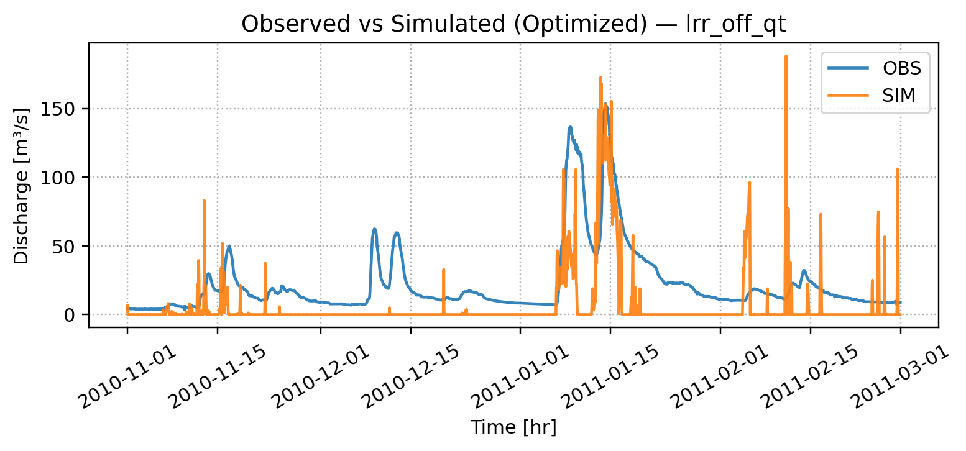
Parameter Optimization
Turning the Lower Reservoir off
NSE: -0.1039
𝑄𝐿 = 𝐿𝑅𝑅_𝐷𝑇𝐻 × 𝐷𝑅𝐸
DRE = 0, ULC = 0, TDR = 1 (from the upper reservoir)
𝐿𝑅𝑅_𝐷𝑇𝐻 = 𝐿𝑅𝑅_𝐷𝑇𝐻 − 𝑄𝐿
𝐿𝑅𝑅_𝐷𝑇𝐻 = 𝐿𝑅𝑅_𝐷𝑇𝐻 + 𝑃𝐿𝑁

Slide 20
Assignment 1: Parameter Optimization
Conclusion and Reflexion
Problems which had to be overcome
Understand exactly how Differential Evolution works to find the „optimal“ parameter
Adapt the initial code to improve convergence
Implement a gradient based optimizer
Make sense of the NSE and which values do make sense and which not
Use of log scales
Understand the model and the given data (internal variables and geographical catchment in a lumped model)
Conclusion for the next task
Not all parameters seem to contribute the same
In our catchment, Lower Reservoir Module seems to play the most important role
With our implementation, we obtain a descend NSE and simulation.
Sensitivity Analysis useful

Slide 21
Local Sensitivity Analysis
21

Slide 22
Assignment 2: Local Sensitivity Analysis
Preconsiderations
Investigating the local sensitivity of the parameters
Assignment 1: Found 18 optimal parameters (hopefully)
Assignment 1: URR seems less sensitive, LRR and SNOW more
First Verification of our results using local sensitivity analysis
Dimension reduction, only one parameter is varied
Expectation: Obtain parabolic OFV plot if parameter is sensitivity in the local sense
Gut feeling: Not good to vary 1 parameter in 18 dimensions

Slide 23
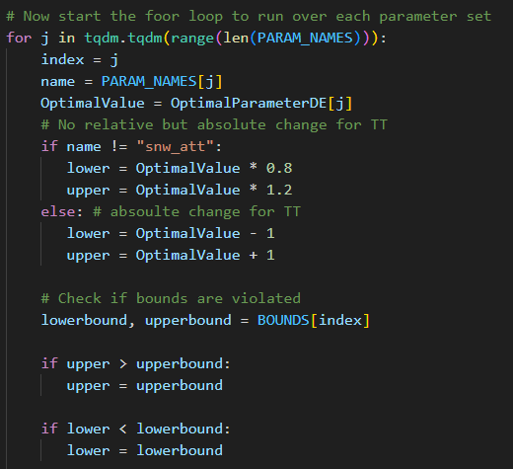
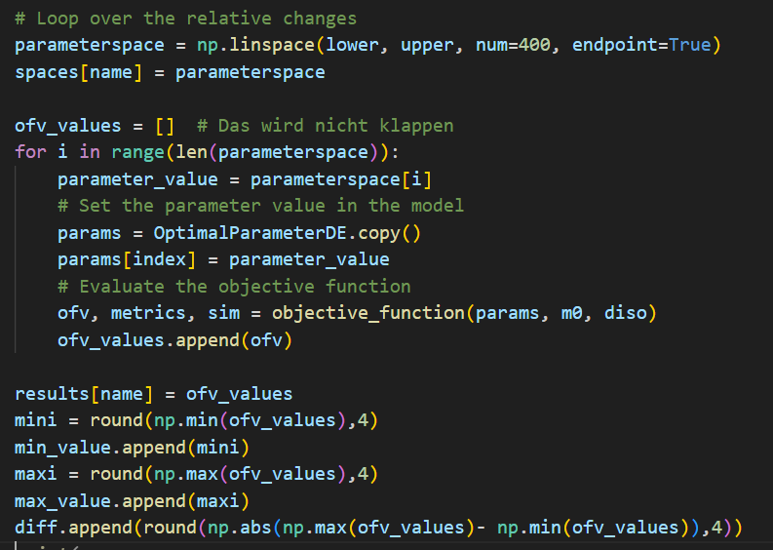
Local Sensitivity Analysis
Implementation

Slide 24
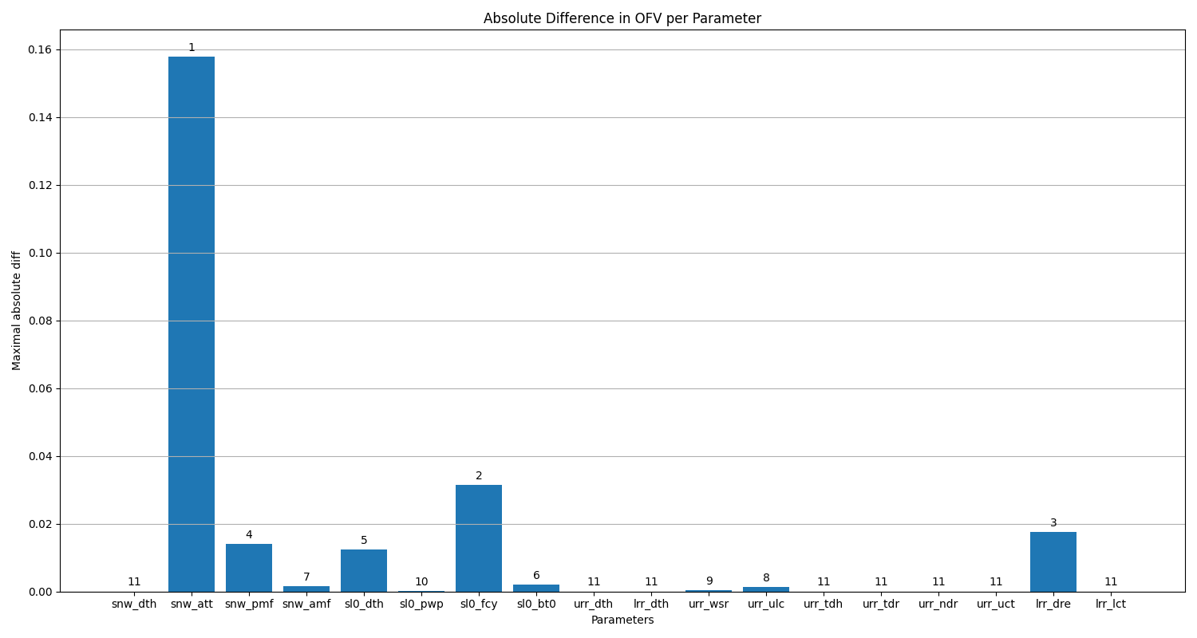
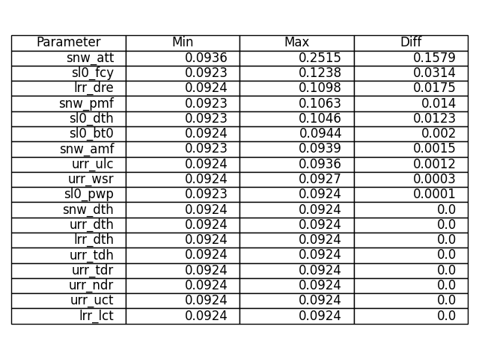
Local Sensitivity Analysis
Result – 20% deviation

Slide 25
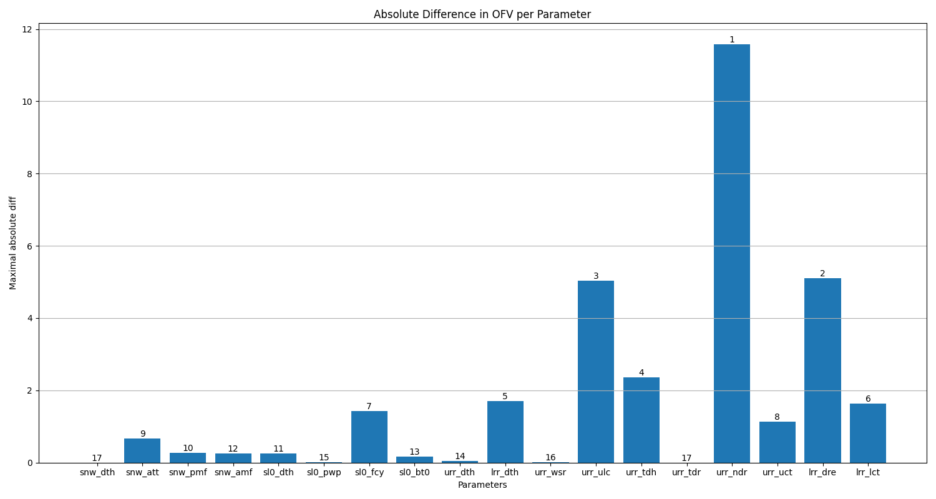
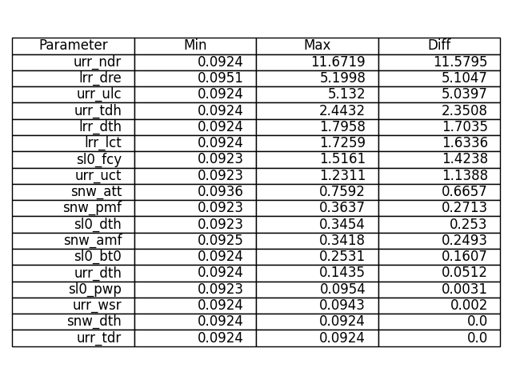
Local Sensitivity Analysis
Result – whole boundaries

Slide 26
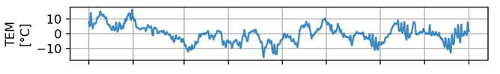
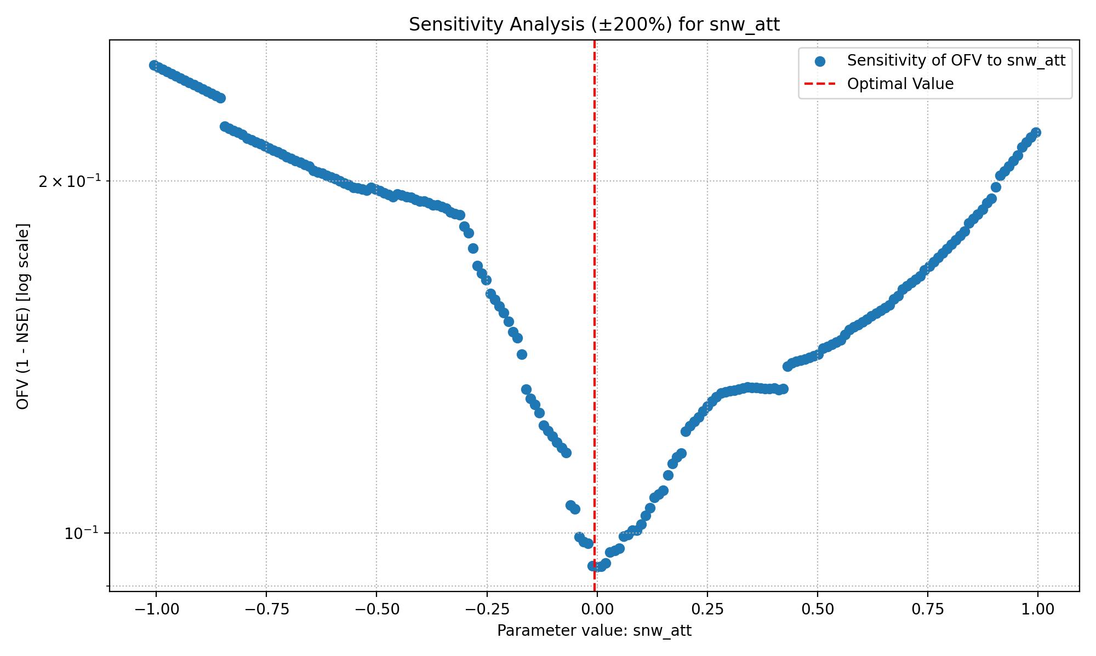
Local Sensitivity Analysis
Snow Fall/Melt Temperature Threshold

Slide 27
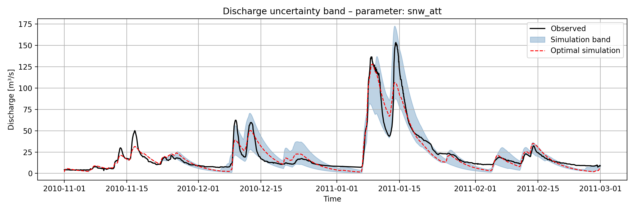
Assignment 2: Local Sensitivity Analysis
Snow Fall/Melt Temperature Threshold
Credits to Group C

Slide 28
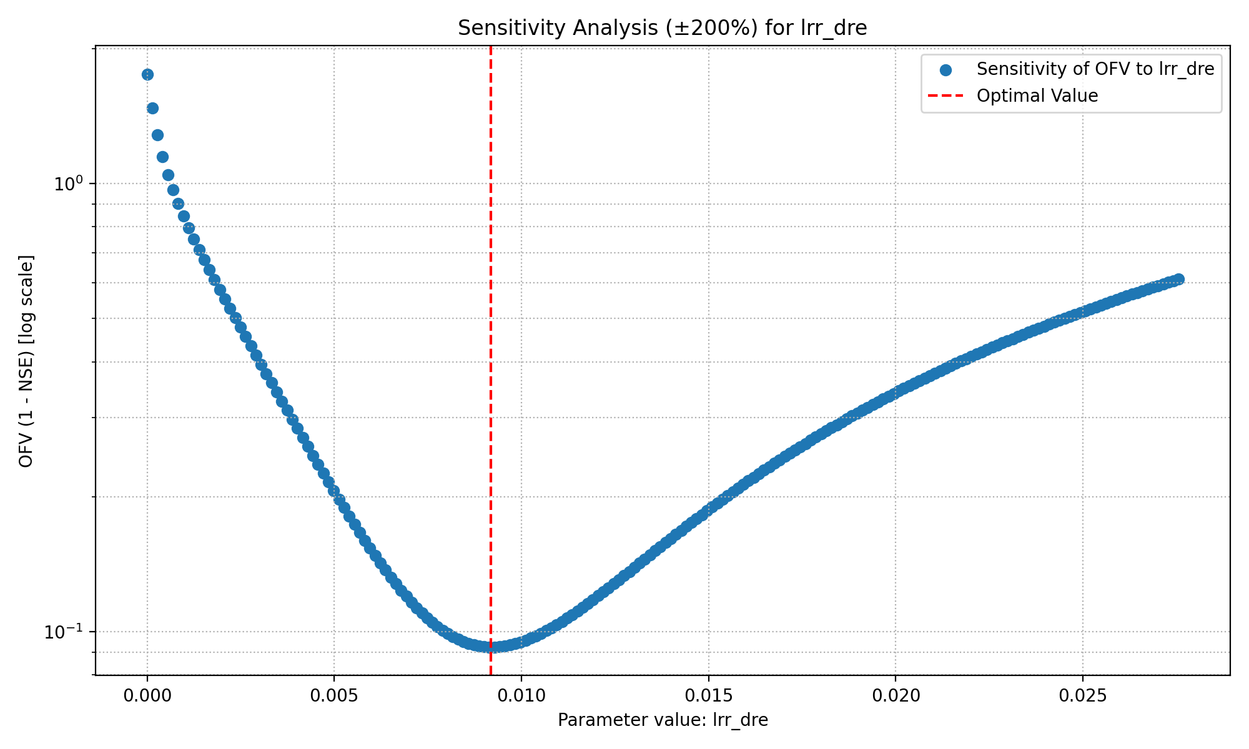
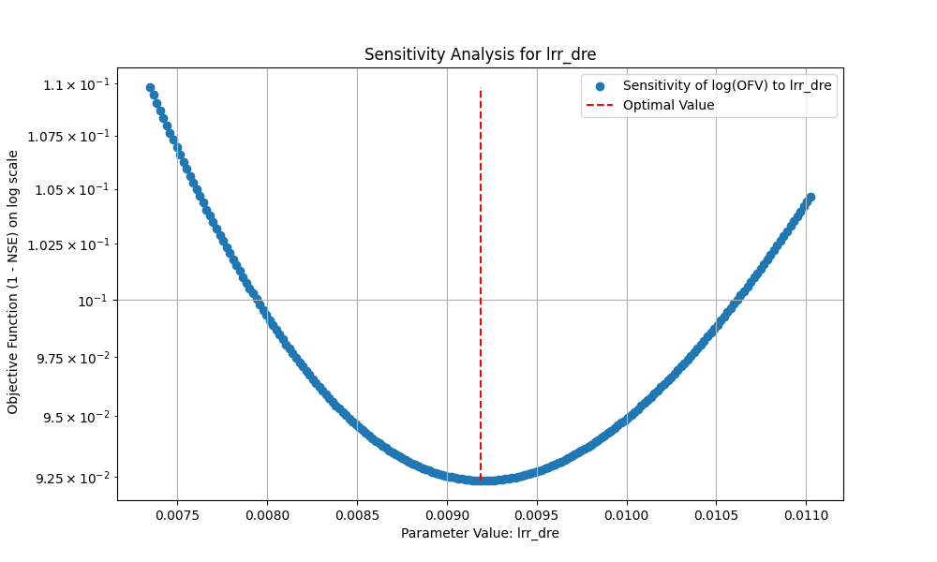
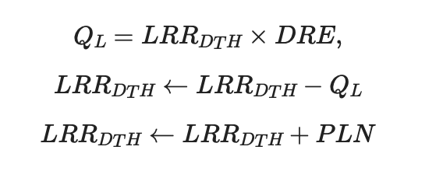
Local Sensitivity Analysis
Discharge Rate

Slide 29

Assignment 2: Local Sensitivity Analysis
Discharge Rate

Slide 30


Local Sensitivity Analysis
Precipitation Melt Factor

Slide 31

Assignment 2 : Local Sensitivity Analysis
Precipitation Melt Factor

Slide 32


Trying to make a sensitive parameter not sensitive
Precipitation Melt Factor (PMF)
Describes the amount of snow melt induced by precipitation (if it rains, snow melts faster)
We still want to account for the effect that precipitation in form of rain increases melt
Suggestion:
$$PMF= \frac{PPT}{SNW_{DTH}+ε}$$
PMF does not play a role anymore
If PPT small but SNW_DTH high => less contribution to MELT
If PPT high(low) and SNW_DTH high(low) , i.e. the same => will be around 1, i.e. PPT does not melt whole snow instantely (PPT does not affect the melt much)
If PPT high and SNW_DTH small => faster melt (think of muddy snow in February/March)
If SNW_DTH = 0 no devision by zero and later on MIN(MLT,SNW_DTH) = SNW_DTH

Slide 33




Trying to make a sensitive parameter not sensitive
Precipitation Melt Factor (PMF) (20 % deviation)
With rewritten PMF
Without rewritten PMF
NSE: 0.8922

Slide 34




Local Sensitivity Analysis
Soil Field Capacity

Slide 35

Assignment 2 : Local Sensitivity Analysis
Soil Field Capacity

Slide 36




Local Sensitivity Analysis
Soil Depth

Slide 37

Assignment 2 :Local Sensitivity Analysis
Soil Depth

Slide 38



Local Sensitivity Analysis
Soil Beta
Idea to make it less sensitive:
-linearization, e.g. apply natural logarithm

Slide 39




Local Sensitivity Analysis
Percolation Coefficient Upper To Lower

Slide 40




Local Sensitivity Analysis
Upper Reservoir Threshold Depth

Slide 41
Assignment 2: Local Sensitivity Analysis
Conclusion and Reflexion
Problems which had to be overcome
Understand shortcomings of local sensitivity analysis
Understand the importance of bounds
Beaware of the nature of the parameter (e.g. SNW_ATT)
Try to fit the big picture
Conclusion for the next task
Assignment 1 observations were verified
URR not locally sensitive
LRR parameters the most sensitive
Soil could be rewritten, in general: It is possible to rewrite the model
Internal variables and time series contributes a lot in the sensitivity
Still missing the big picture: Varying all parameters to determine sensitvity (Global)

Slide 42
Global Sensitivity Analysis
42

Slide 43
Global Sensitivity Analysis
Preconsiderations
Investigating the global sensitivity of the parameters
Assignment 1: Optimiziation to find best parameters
Assignment 2: Local sensitivity anlysis (shortcomings)
Sobol indices to get a global sensitivity

Slide 44





Global Sensitivity Analysis
Paper Satelli et al. – theoretical background
Model setup: $Y=f\left(X_{1},.. , X_{d}\right)$where $f$ is our objective function and $Y$ OFV
Base: Variance based methods using Monte Carlo
Core idea: Hoeffeding decomposition: $f=f_{0}+ \sum_{i}{f_{i}}+ \sum_{i}{\sum_{j>i}{f_{ij}+ …+ f_{12…d}}}$
Here: $f_{0}=E\left(y\right), f_{i}=E_{X_{i}}\left(Y | X_{i}\right)−E\left(Y\right), f_{ij}=E_{X_{ij}}\left(Y | X_{i},X_{j}\right)−f_{i}−f_{j}−E\left(Y\right)$
Apply this to the our OFV
First-order (main effect):
Total-effect (main + all interactions):
„Expected reduction in variance that would be obtained if $X_{i}$ could be fixed“
„Expected variance that would be left if all factors but $X_{i}$ could be fixed“

Slide 45



Global Sensitivity Analysis
Setup Code

Slide 46


Global Sensitivity Analysis
Sobol Sampling

Slide 47

Global Sensitivity Analysis

Slide 48

Global Sensitivity Analysis
Sobol Sampling

Slide 49

Global Sensitivity Analysis

Slide 50

Global Sensitivity Analysis
Sobol Sampling

Slide 51


Global Sensitivity Analysis
Sobol Sampling – Full Range
Parameter | S1_Full_NSE | ST_Full_NSE | S1_Full_LnNSE | ST_Full_LnNSE
snw_dth | 0.0108 | 0.0 | 0.0075 | 0.0
snw_att | 0.0113 | 0.002 | 0.4568 | 0.4642
snw_pmf | 0.0108 | 0.0 | 0.0076 | 0.0
snw_amf | 0.0106 | 0.0006 | 0.0078 | 0.0006
sl0_dth | 0.011 | 0.0004 | 0.0286 | 0.0275
sl0_pwp | 0.0108 | 0.0 | 0.0076 | 0.0002
sl0_fcy | 0.0141 | 0.0042 | 0.0925 | 0.1345
sl0_bt0 | 0.0112 | 0.001 | 0.141 | 0.1865
urr_dth | 0.0408 | 0.026 | 0.0075 | 0.0
lrr_dth | 0.3807 | 0.5895 | 0.0075 | 0.0
urr_wsr | 0.0108 | 0.0 | 0.0083 | 0.001
urr_ulc | 0.0107 | 0.0042 | 0.0144 | 0.0286
urr_tdh | 0.0104 | 0.0006 | 0.0076 | 0.0
urr_tdr | 0.011 | 0.0003 | 0.0076 | 0.0
urr_ndr | 0.0163 | 0.0103 | 0.0259 | 0.0379
urr_uct | 0.0108 | 0.0001 | 0.0162 | 0.039
lrr_dre | 0.3697 | 0.587 | 0.0401 | 0.1082
lrr_lct | 0.0114 | 0.0018 | 0.0778 | 0.1424
SUM | 0,9632 | 1,2280 | 0,9623 | 1,1706

Slide 52


Global Sensitivity Analysis
Sobol Sampling – Narrow Range
Parameter | S1_Narrow_NSE | ST_Narrow_NSE | S1_Narrow_LnNSE | ST_Narrow_LnNSE
snw_dth | 0.0 | 0.0 | 0.0006 | 0.0
snw_att | 0.0 | 0.0 | 0.0006 | 0.0
snw_pmf | 0.0964 | 0.1563 | 0.0006 | 0.0005
snw_amf | 0.0027 | 0.0508 | 0.0028 | 0.0028
sl0_dth | 0.0263 | 0.2996 | 0.0022 | 0.0209
sl0_pwp | 0.0 | 0.0003 | 0.0006 | 0.0
sl0_fcy | 0.1948 | 0.5856 | 0.0147 | 0.0344
sl0_bt0 | 0.0025 | 0.0139 | 0.0005 | 0.0043
urr_dth | 0.0003 | 0.0003 | 0.0012 | 0.0007
lrr_dth | 0.0001 | 0.0 | 0.0008 | 0.0001
urr_wsr | 0.0001 | 0.0003 | 0.0006 | 0.0
urr_ulc | -0.0011 | 0.0122 | 0.0009 | 0.0003
urr_tdh | 0.0 | 0.0 | 0.0006 | 0.0
urr_tdr | 0.0 | 0.0 | 0.0006 | 0.0
urr_ndr | 0.0 | 0.0 | 0.0006 | 0.0
urr_uct | -0.0 | 0.0 | 0.0006 | 0.0
lrr_dre | 0.1825 | 0.3823 | 0.9566 | 0.9585
lrr_lct | 0.0 | 0.0 | 0.0007 | 0.0
SUM | 0,5046 | 1,5016 | 0,9858 | 1,0225

Slide 53



Global Sensitivity Analysis
NSE versus LN-NSE
Nash Sutcliffe Efficiency
Log Nash Sutcliffe Efficiency
Small simulated discharges are enhanced in log
Large flows take less influence
If observation and simulation differs a lot, log amplifies

Slide 54

Global Sensitivity Analysis
Comparing the Effect of Objective Function

Slide 55

Global Sensitivity Analysis
Comparing Effect of Parameter Range

Slide 56
Global Sensitivity Analysis
Conclusion and Reflexion
Problems which had to be overcome
Understand the difference between first- and total-order-indices
Understand the importance of bounds
Beaware of the nature of the parameter (e.g. SNW_ATT)
Try to fit the big picture
Runtime

Slide 57
Big Picture: Combining All 3 Assignments
42

Slide 58


Big Picture: Combining All 3 Assignments
Discharge Rate
Parameter | S1_Full_NSE | ST_Full_NSE | S1_Full_LnNSE | ST_Full_LnNSE
lrr_dre | 0.3697 | 0.587 | 0.0401 | 0.1082

Slide 59


Big Picture: Combining All 3 Assignments
Upper Reservoir Threshold Depth
Parameter | S1_Full_NSE | ST_Full_NSE | S1_Full_LnNSE | ST_Full_LnNSE
urr_tdh | 0.0104 | 0.0006 | 0.0076 | 0.0

Slide 60


Big Picture: Combining All 3 Assignments
Soil field capacity
Parameter | S1_Full_NSE | ST_Full_NSE | S1_Full_LnNSE | ST_Full_LnNSE
sl0_fcy | 0.0141 | 0.0042 | 0.0925 | 0.1345

Slide 61
Big Picture: Combining All 3 Assignments
Soil depth
Parameter | S1_Full_NSE | ST_Full_NSE | S1_Full_LnNSE | ST_Full_LnNSE
snw_dth | 0.0108 | 0.0 | 0.0075 | 0.0

Slide 62


Big Picture: Combining All 3 Assignments
Snow Melt Temperature Threshold
Parameter | S1_Full_NSE | ST_Full_NSE | S1_Full_LnNSE | ST_Full_LnNSE
snw_att | 0.0113 | 0.002 | 0.4568 | 0.4642

Slide 63

Big Picture: Combining All 3 Assignments
Precipitation Melt Factor
Parameter | S1_Full_NSE | ST_Full_NSE | S1_Full_LnNSE | ST_Full_LnNSE
snw_pmf | 0.0108 | 0.0 | 0.0076 | 0.0

Slide 64

Big Picture: Combining All 3 Assignments
Snow parameters:
snw_att: MUCH higher with LnNSE (green ~0.5) than NSE (blue ~0.0)
Snw_pmf: this parameter becomes moderately important for peak matching (NSE) but remains unimportant for baseflow/low flows (LnNSE).
Soil parameters:
Soil_fcy: Similar in both (green ~0.15, blue small)
Soil_dth: soil depth becomes critical for matching peaks with NSE but remains unimportant for matching low flows with LnNSE.
Lower and Upper reservoir parameters:
lrr_dre: HIGH in both NSE (blue ~0.6) and LnNSE (green ~0.5)
urr_tdh: same for both metrics. This parameter is neligible.

Slide 65
Big Picture: Combining All 3 Assignments
Parameters Important for both NSE and LnNSE (Globally Important):
lrr_dre (baseflow discharge) - controls both peaks and recessions
Parameters Important only for NSE (Peak-Specific):
sl0_dth (soil depth) - affects peak storage/generation
snw_pmf (precip melt factor) - affects snowmelt peak amplification
sl0_fcy (soil field capacity) - affects infiltration during events
Parameters Important only for LnNSE (Baseflow-Specific):
snw_att (snow temp threshold) - affects when baseflow season starts
Parameters Important for neither (Negligible):
urr_tdh and other URR parameters

Slide 66
Key Findings & Conclusions
✓ Successful calibration (NSE = 0.901) using Differential Evolution
✓ Snow and lower reservoir modules are critical for model performance
✓ Soil field capacity and discharge rate show highest local sensitivity
✓ Global sensitivity analysis reveals important parameter interactions

Slide 67
Thank You!

